Slide 1

More app modernization.
Less platform management.

Slide 2

What we’ll discuss today
Agenda
Roadmap
Market challenges
Why Red Hat for cluster management
Red Hat Advanced Cluster Management

Slide 3
UPDATED Aug 1st
RHACM Roadmap
Near Term (3 months / 2.12)
Mid Term
(6 months / 2.13)
Long Term
(9+ months / 2.14+)
Multicluster Observability-Addon for Logging, Tracing and OpenTelemetry (DP)
Automated ROSA discovery and import (GA)
Cluster Lifecycle for ROSA HCP (TP)
Deploy and manage Hosted Control Planes (HyperShift) - Power/Z (GA)
Visualize OCP worker cores (subscriptions)
Managing cluster relocation (DP)
Alert Management UI (DP)
Incident Detection based on Alert Grouping (DP)
Global Hub Event Driven Ansible Integration (DP)
Cross-namespace referencing for hub templates
Policy content development CLI tooling
Git direct-to cluster policy support & ArgoCD integration enhancements (TP)
OpenShift GitOps with CNCF conformant K8s with user-provided API server
Unified SiteConfig integration with MCE (TP)
CSV export support for ACM/MCE tables
ACS integration with Global Hub (DP)
Custom Messages in ConfigurationPolicy
Device edge management integration (DP)
Right-size recommendations for namespaces (TP)
Cluster Lifecycle for ARO (DP)
Cluster Lifecycle for ROSA HCP (GA)
Automated ARO discovery and import (DP)
Alert Management UI (TP)
Incident Detection based on Alert Grouping (TP)
Enhanced Observability with OpenShift Virtualization (search, capacity-management)
Global Hub Inventory search view (GA)
Global Hub Event Driven Ansible Integration (TP)
Device edge management integration (TP)
Visualize RHDE power consumption (DP)
Fleet OLM operator management (TP)
Git direct-to cluster policy support & ArgoCD integration enhancements (GA)
Dynamic template plugin for OpenShift GitOps (TP)
Cluster Lifecycle for ARO (TP)
Cluster provisioning with short lived tokens (AWS STS, GCP WIF, Azure Identity)
Deploy and manage Hosted Control Planes (HyperShift) - Non-BM Agent provider (GA)
Alert Management UI (GA)
Incident Detection based on Alert Grouping (GA)
Fine grained RBAC for RHACM Observability (GA)
ArgoCD-Instance Management in ACM-UI
Enhanced management with Hosted Control Planes
Enhanced support for OCP updates (z-stream rollback and EUS-to-EUS updates)
Integration with certificate management
ArgoCD Agent Integration
Enhanced Support for Placement in UI
Enhanced Integration with OpenShift Virtualization (rightsizing, advanced Dashboards)
Fleet OLM operator management (GA)
ACM
ACM
ACM
DP = Developer Preview
TP = Technology Preview
GA = Generally Available
Product Managers: Scott Berens, Christian Stark, Bradd Weidenbenner, Sho Weimer, August Simonelli
Notes:
Please do not send this deck. Instead rely on established channels for roadmap sharing, specifically what’s new and next series
Jira links are included. hyperlink formatting (*underline and red color*) has been removed
See red.ht/observability-roadmap for features delivered in cooperation with Observability engineering

Slide 4



OpenShift Delivers Continuous Security
Control
Protect
Detect & Respond
ACM
Application Lifecycle & Locally
Fleet Management
Fleet Observability & Alerts
Vulnerability Analysis
Policy Admission Controller
Runtime Behavioral Analysis
ACS
App config Analysis
Compliance Assessments
Auto-suggest Network Policies
APIs for CI/CD integrations
Risk Profiling
Threat Detection / Incident Response
Trusted Content
Kubernetes Platform Lifecycle
Container Isolation
Container Registry
Identity & Access Management
Network Isolation
OCP
Build Management
Platform Data
Application Access & Data
CI/CD Pipeline
Deployment Policies
Observability
BUILD
DEPLOY
RUN
DevSecOps

Slide 5

Deploy: Protect the application platform
Best practices
Reduce attack surface with a container optimized operating system
Use automated and policy-driven configuration management across your fleet
Implement least privilege with fine-grained role based access control (RBAC)
Encrypt platform data in transit and at rest
Use automated compliance, risk assessment and remediation solutions
Reduce deployment risk with admission control policies that
Minimize admission of privileged pods, pods with host capabilities
Prevent admission of pods with critical vulnerabilities
RHEL CoreOS
Project A
Project B
Project B with Service Mesh
OCP Operators
ACM
Project C
OCP RBAC
ACS to monitor
ACM to enforce
Pod [ containers ]
OCP CAs
Service mesh
OCP IPSec RHCOS NBDE
Encrypt etcd
Software Defined Network (SDN) plug-in
kubernetes
OCP Compliance Operator
ACS
ACM
Red Hat Enterprise Linux CoreOS
OCP Security Context Constraints
ACS
Notes:
Logos Included to help clarify which part of our offerings provide which capabilities
Encryption of data stored in etcd is supported as of 4.3
You also need to secure the container platform itself -- the orchestration tool you use to manage deploying container instances at scale. You use the orchestration layer, the control plane to
Determine which containers should be deployed to which hosts
manage shared resources like network and storage
Enable containers to discover each other and prevent containers from discovering each other
Automatically scale application capacity to meet demand
The orchestration masters are a central point of access and should receive the highest level of security scrutiny.
The OpenShift master includes a built-in role-based access controls which can integrate with the identity provider of your choice.
Multi-tenancy security is a must for the platform itself to enable developer self-service and make sure teams do not access each other’s environments without authorization. You need a self-service portal that gives enough control to teams to foster collaboration while still providing security. OpenShift adds several components to Kubernetes to ensure a secure multi-tenant master:
All access to the master is over TLS
Access to the API Server is X.509 certificate or token based
Project quota is used to limit how much damage a rogue token could do
Etcd is not exposed directly to the cluster
Reduce attack surface with a container optimized operating systems
Use automated and policy-driven configuration management across your fleet
Implement least privilege with fine-grained role based access control (RBAC)
Encrypt platform data in transit and at rest
Use automated compliance assessment and remediation to meet regulatory obligations
Reduce deployment risk with admission control policies
Minimize admission of privileged pods, pods with host capabilities
Prevent admission of pods with critical vulnerabilities

Slide 6
Market challenges
Red Hat Advanced Cluster Management for Kubernetes

Slide 7
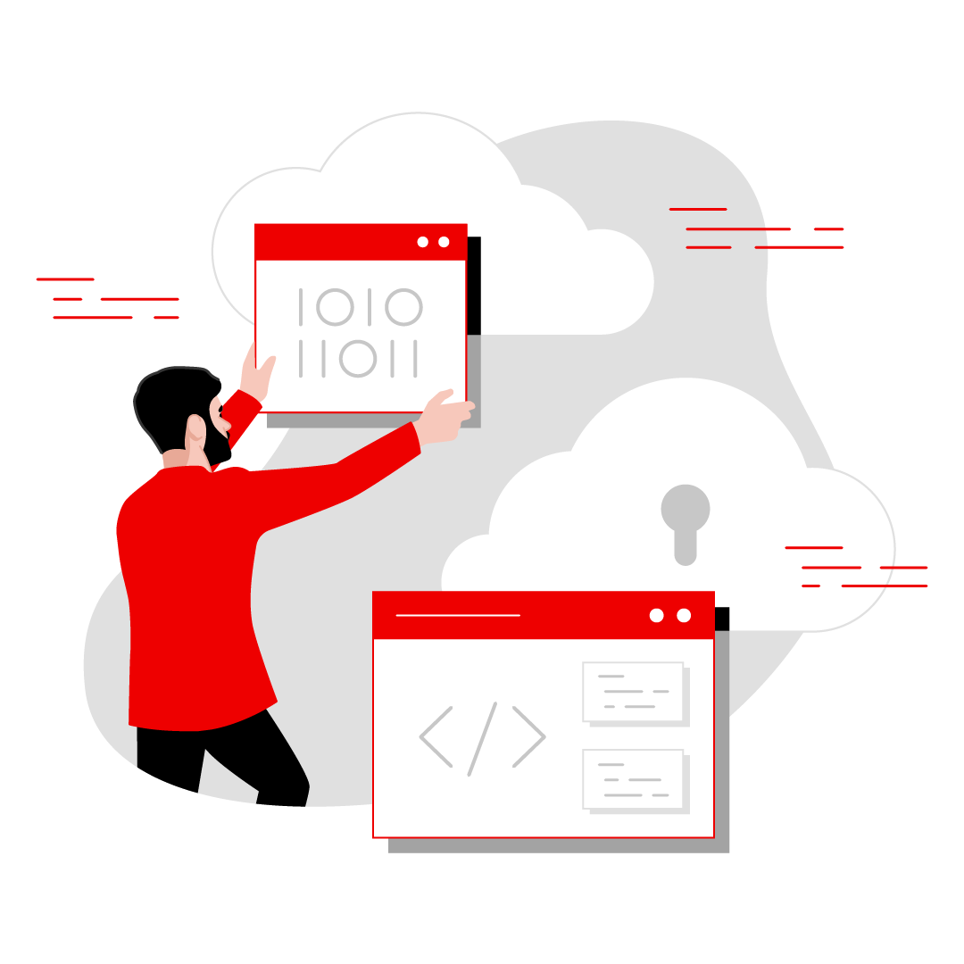
Factors driving the move to cloud-native apps and hybrid cloud
Market challenges
Operations teams must address a number of new scenarios
Distributed apps on production and non-production environments
Different geopolitical, security, and regulatory guidelines
Disaster recovery and zero downtime plans
Multi-team and multi-tenant scenarios
Edge and internet-of-things (IoT) deployments
Capital expenditure cost reduction
Hybrid architectures with minimized latency
Avoiding vendor lock-in

Slide 8
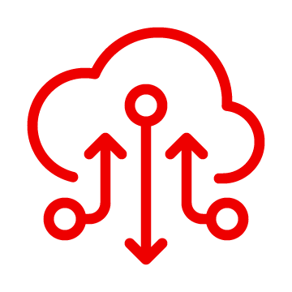

Cloud-native applications rely on multicluster infrastructure
Market challenges
86%
62%
of companies report an increase in the volume and/or scope of their cloud initiatives since 2020*
of companies report being “heavy adopters” versus just 11% in 2020*
* Race to the cloud: Reaching the inflection point to long-sought value, Accenture, May 2023.

Slide 9
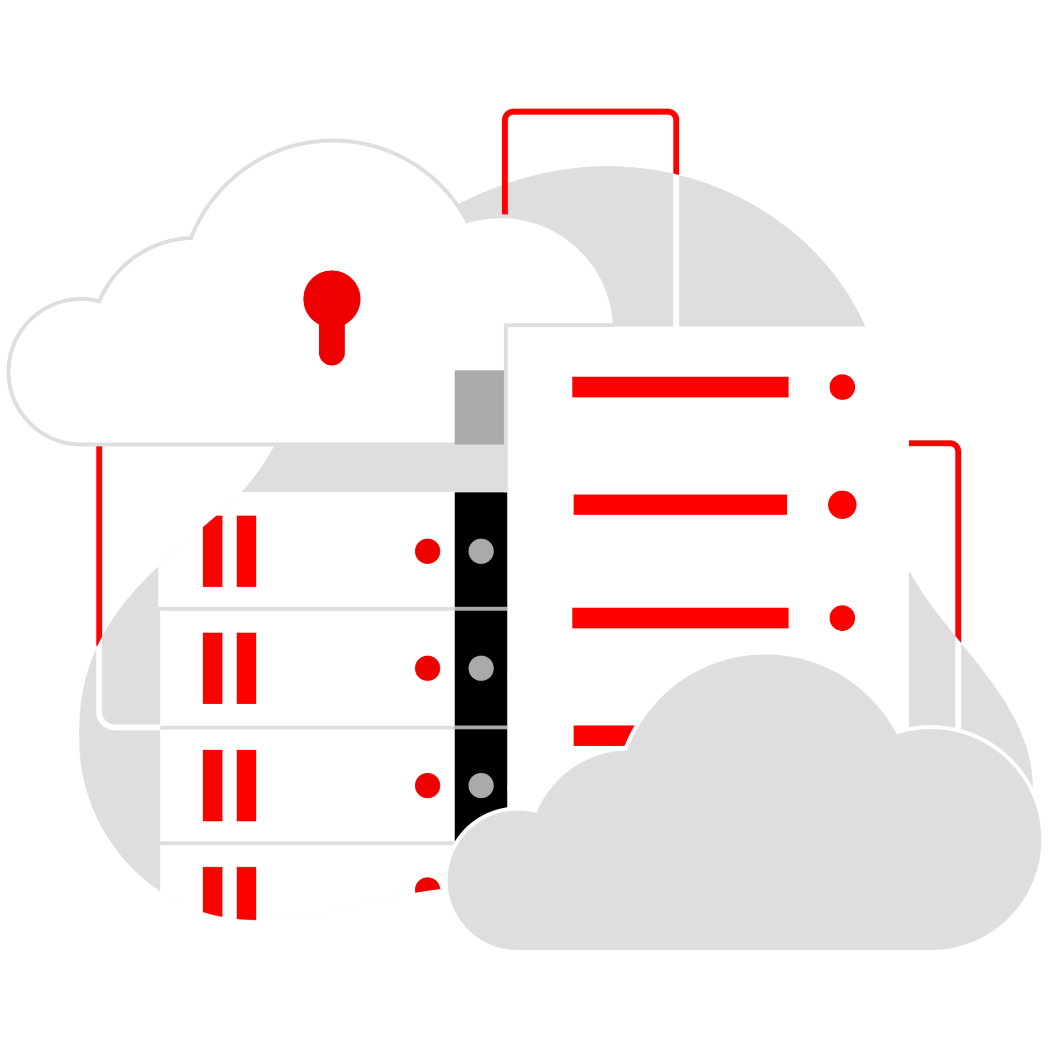

Larger enterprises have embraced hybrid cloud architecture
Market challenges
50%
of Kubernetes users have more than 10 clusters*
* CNCF-annual-survey-2022

Slide 10

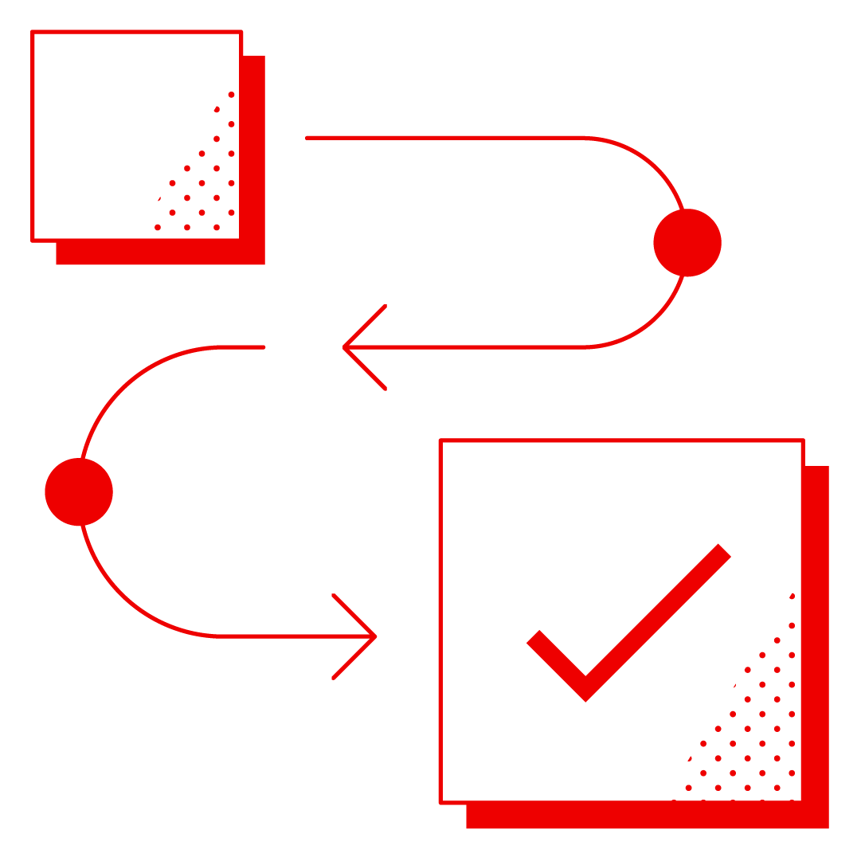


Market challenges
Single cluster
Challenges exist at
every phase of your multicluster journey
Complicated cluster provisioning
Manual, error-prone application deployment
Availability and fault tolerance
Managing tenancy
Regulatory compliance for infrastructure
Application latency
Multiple clusters
Multiple consoles to monitor
Distributed business applications
Inconsistent operational controls
Operational overhead
Governance and configuration management
Implementing disaster recovery
Geographically distributed clusters
Complex regional and geo-specific regulations
Holistic management of the entire fleet
Latency between data centers and geo boundaries

Slide 11
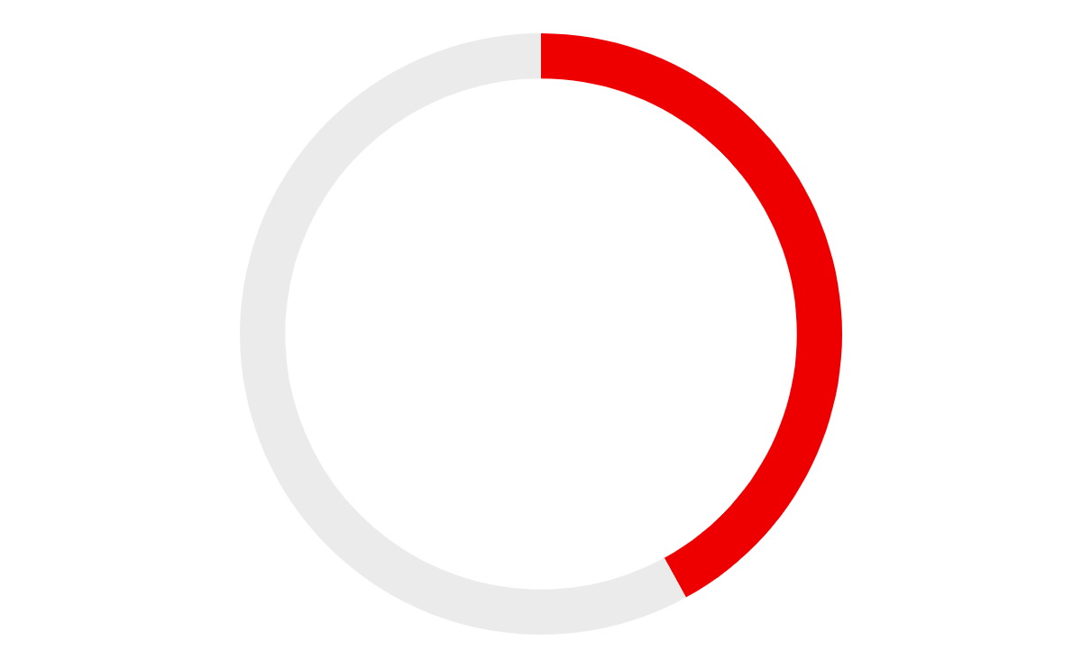

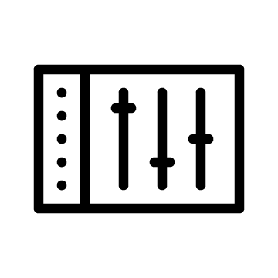

Multicluster environments need a unified management control plane
Market challenges
How important is a unified management control plane?
Why is a unified management control plane important?
71% very important
42%
Improve data integration and data protection
22% somewhat important
41%
Optimize infrastructure costs and usage
7% not important
*Source: Future of Digital Infrastructure Agenda Q2 Survey 2021, IDC, June, 2021.

Slide 12



Manage your Kubernetes clusters from one place
Market challenges
Organizations need end-to-end management across datacenters and public cloud environments
Multicluster management
Governance
Run your operations from anywhere that Red Hat OpenShift runs and manage any Kubernetes cluster in your fleet.
Consistently enforce policies across environments with configuration drift alerts and remediation.
Availability
Visibility
Control the placement of workloads based on capacity and policy with the confidence of data recovery and continuity.
Monitor usage across multiple clouds and identify root causes of failed components.

Slide 13
Why Red Hat?
Red Hat Advanced Cluster Management for Kubernetes

Slide 14
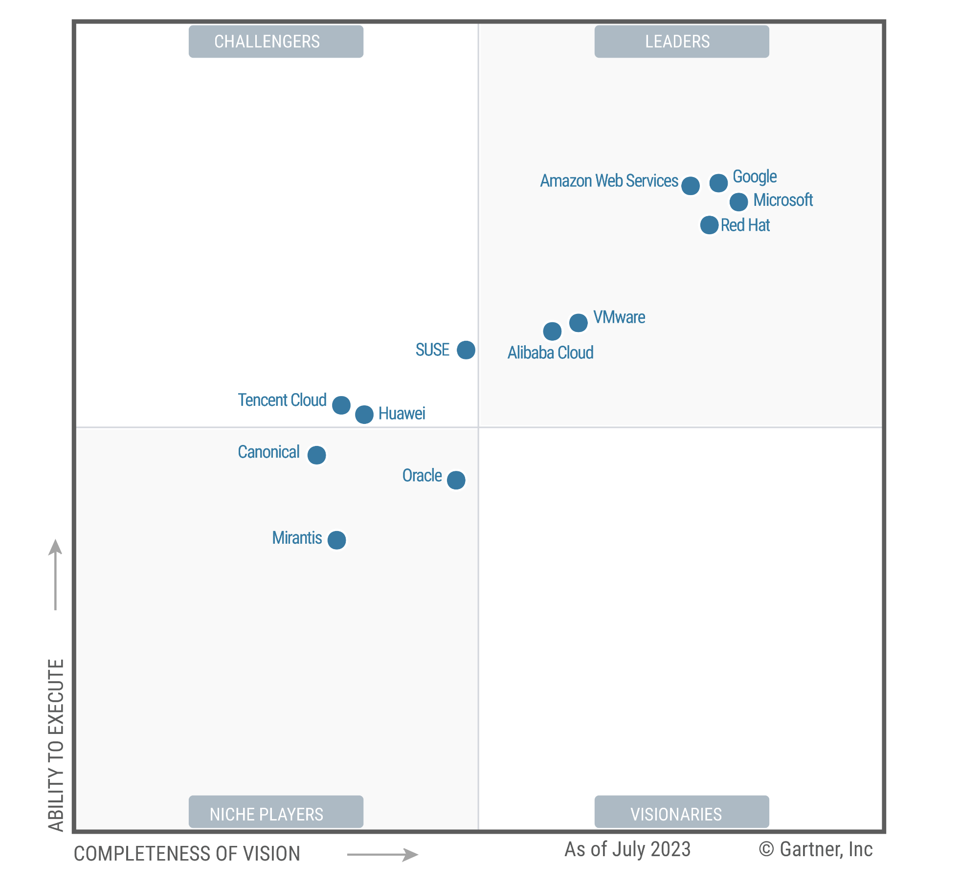
Red Hat is a Leader in the 2023 Gartner® Magic Quadrant™: Container Management
Red Hat
Source: Gartner, “Magic Quadrant for Container Management,” September 2023
GARTNER is a registered trademark and service mark of Gartner and Magic Quadrant is a registered trademark of Gartner, Inc. and/or its affiliates in the U.S. and internationally and are used herein with permission. All rights reserved. This graphic was published by Gartner, Inc. as part of a larger research document and should be evaluated in the context of the entire document. The Gartner document is available upon request from Red Hat. Gartner does not endorse any vendor, product or service depicted in its research publications, and does not advise technology users to select only those vendors with the highest ratings or other designation. Gartner research publications consist of the opinions of Gartner research organization and should not be construed as statements of fact. Gartner disclaims all warranties, express or implied, with respect to this research, including any warranties of merchantability or fitness for a particular purpose.
Notes:
NOTE: This slide is approved by Gartner. Please use as-is. Please do not modify it in any way. Thank you.

Slide 15
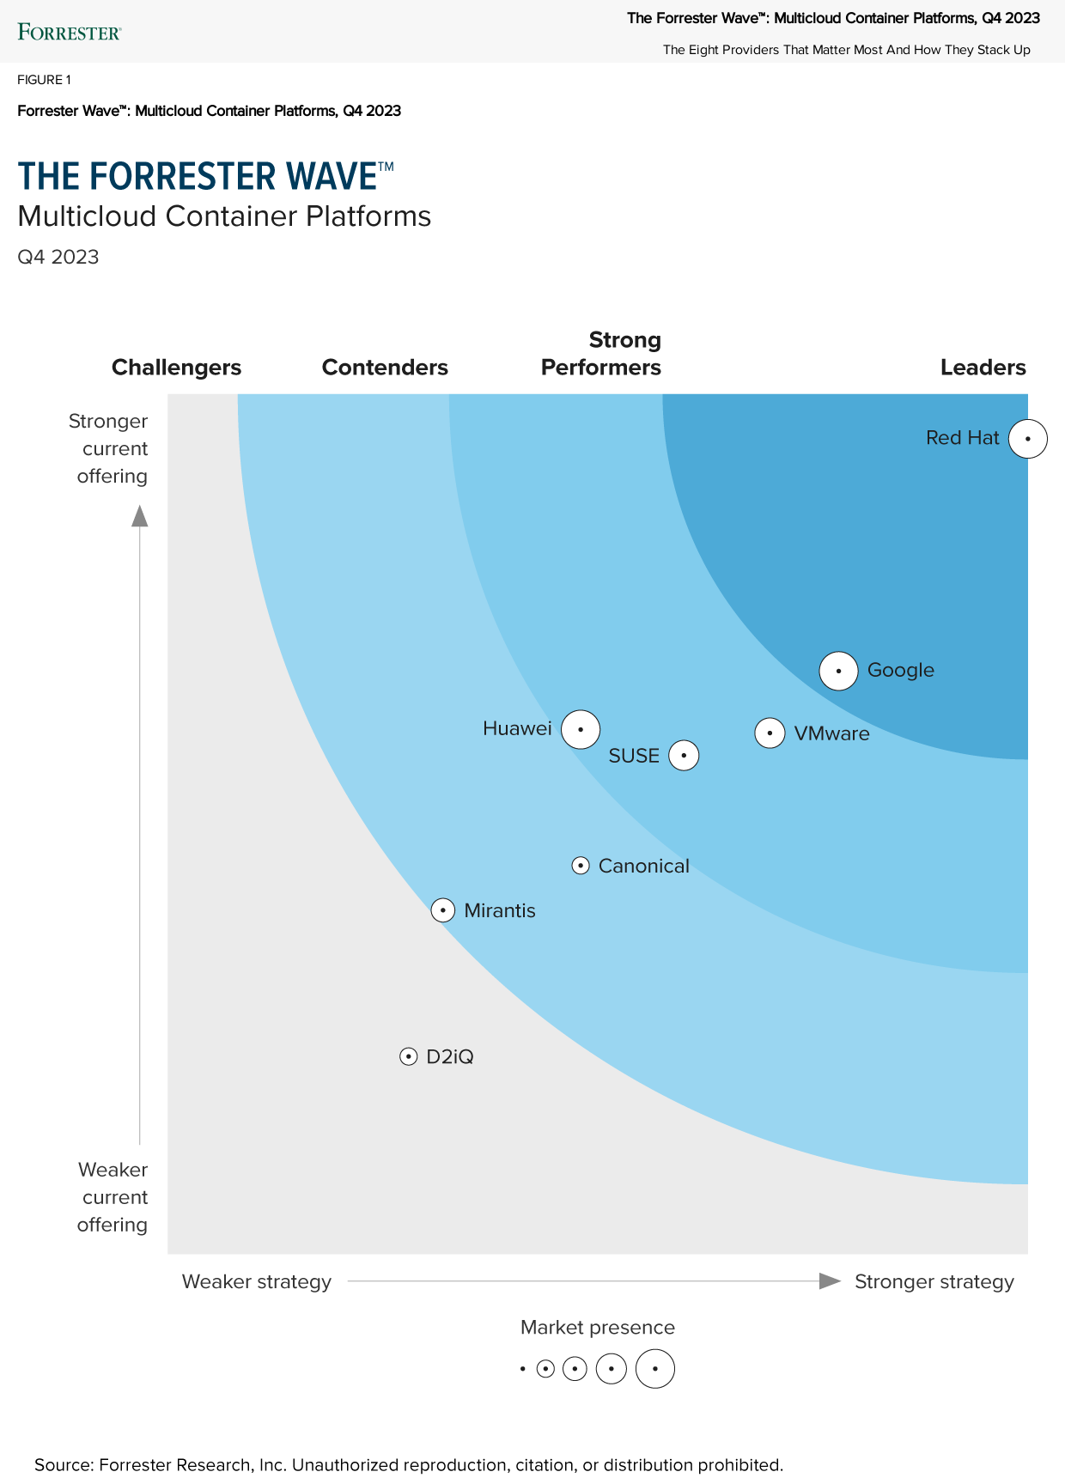
The Forrester Wave™: Multicloud Container Platforms, Q4 2023
“Red Hat sets the pace with enterprise IT capabilities and massive market presence. With OpenShift’s systematic innovation and development on multiple fronts, Red Hat has helped transform the MCP market segment.”
“The demand for OpenShift prompted AWS and Microsoft Azure to sell OpenShift as a managed service, despite having their own Kubernetes-based container services. Red Hat’s differentiated strategic vision is to up the ante on enterprise-grade open source computing.”
The Forrester Wave™: Multicloud Container Platforms, Q4 2023: The Eight Providers That Matter Most and How They Stack Up
Oct 2023
15
The Forrester Wave™ is copyrighted by Forrester Research, Inc. Forrester and Forrester Wave™ are trademarks of Forrester Research, Inc. The Forrester Wave™ is a graphical representation of Forrester’s call on a market and is plotted using a detailed spreadsheet with exposed scores, weightings, and comments. Forrester does not endorse any vendor, product, or service depicted in the Forrester Wave™. Information is based on best available resources. Opinions reflect judgment at the time and are subject to change.
Notes:
This slide is APPROVED by Forrester

Slide 16
Overview of Red Hat Advanced Cluster Management
Red Hat Advanced Cluster Management for Kubernetes

Slide 17

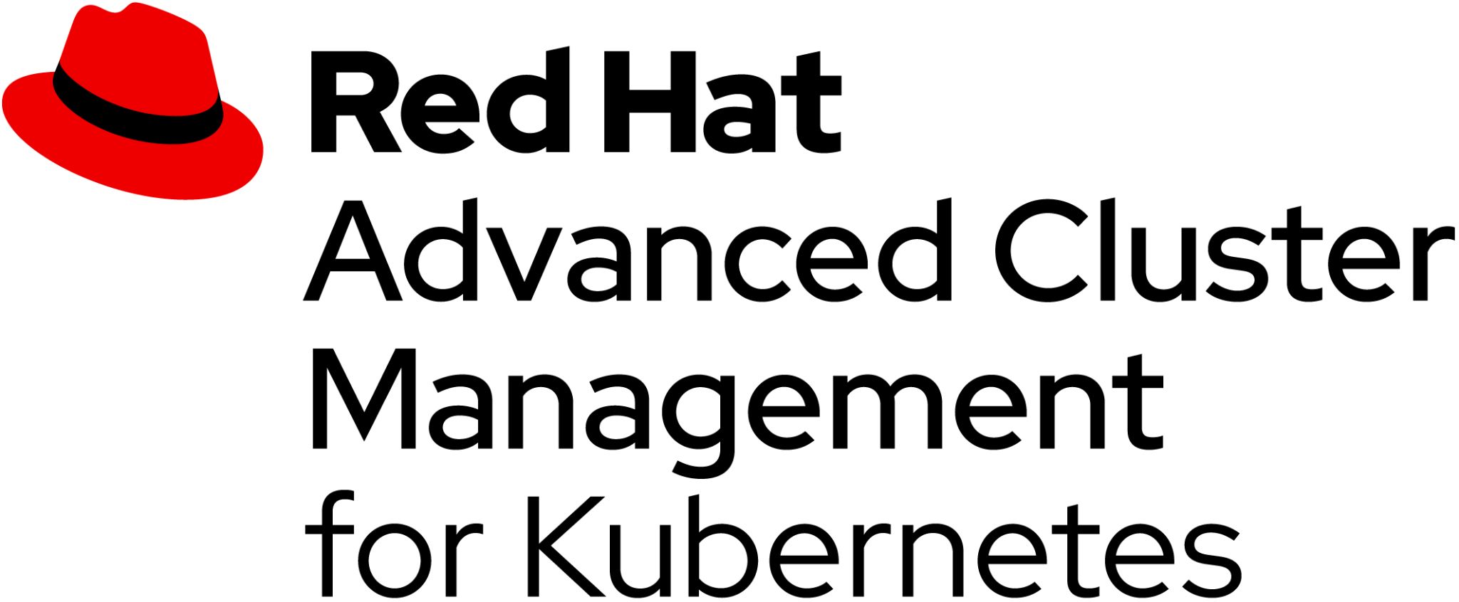





Overview
Accelerate software development with self-service provisioning
Increase application availability with placement rules to quickly deploy in different locations to match capacity
Simplify IT operations with self-service to allow teams to directly set up cluster environments
More easily meet compliance requirements with centralized policy enforcement across environments
Reduce operational costs for multicloud environments with a single management environment
End-to-end management
for clusters and applications from a single console
Included in Red Hat OpenShift Platform Plus

Slide 18
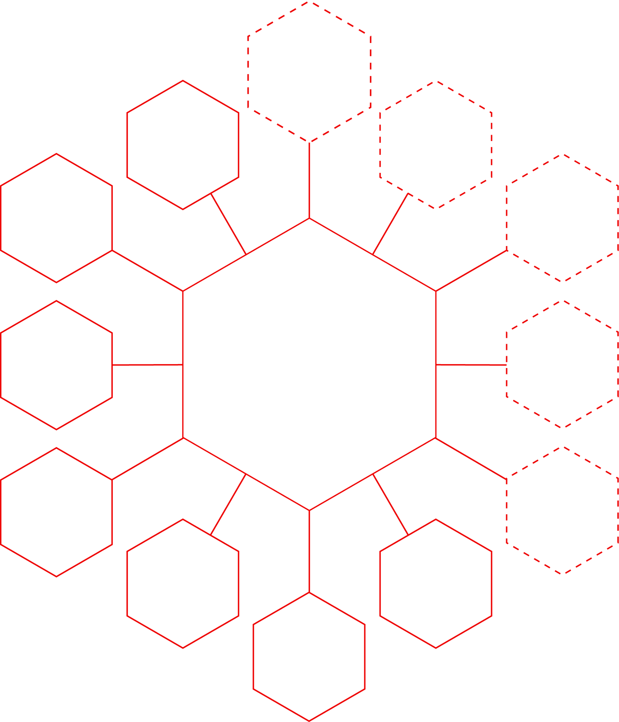

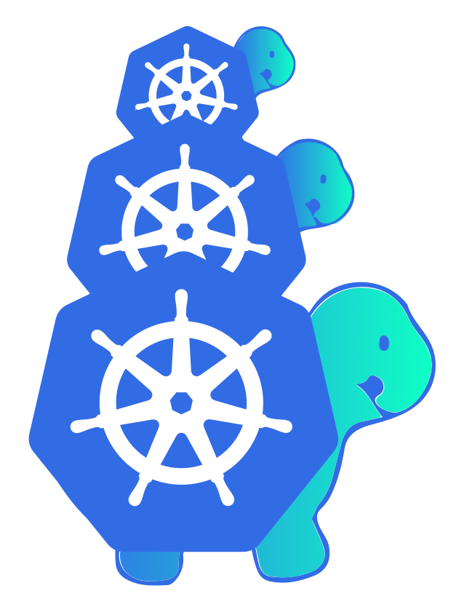








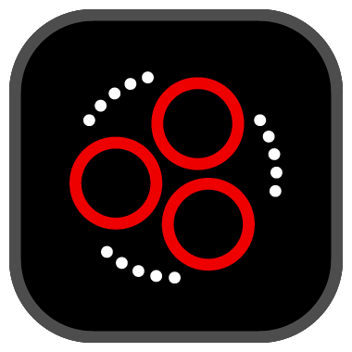







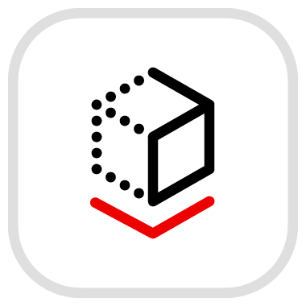
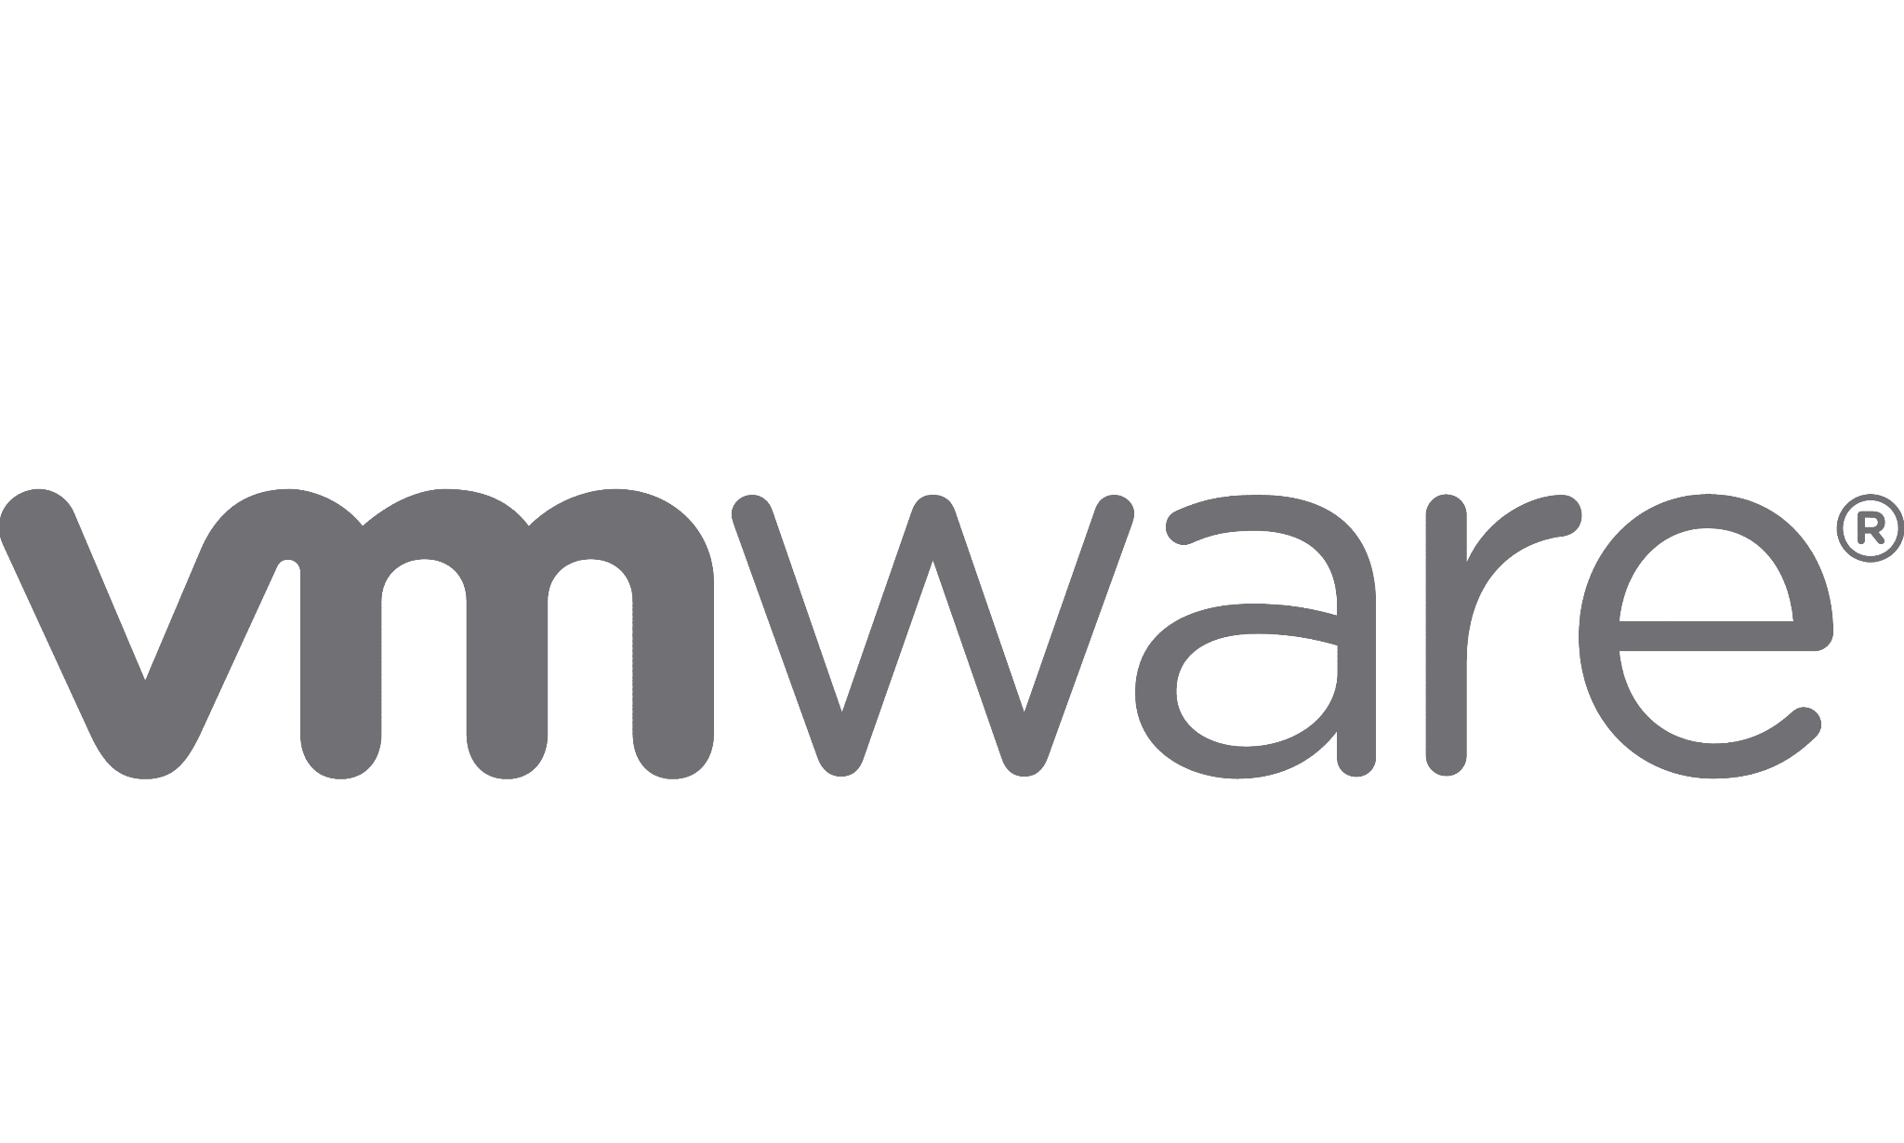
Overview
Runs on Red Hat OpenShift Easily run and manage it on top of an OpenShift cluster
Hub-and-spoke architecture Manage all configurations and Kubernetes clusters with a central hub
Tight integration Integrate with key enterprise solutions and open source tools with a robust application programming interface (API) and add-ons
Hub cluster
Notes:
Dotted line indicates an opensource tool/project

Slide 19


Open cluster management
Overview
Commitment to open source
CNCF sandbox project
Community ecosystem and partners Collaboration in Kubernetes special interest groups (multicluster, app, policy) with contributors from Ant Group, Alibaba, and Tencent
Multicluster management foundation Red Hat Advanced Cluster Management multicluster management control plane foundation
Kubernetes native Built on the Kubernetes API and etcd via custom resource definitions (CRDs)

Slide 20

Red Hat Advanced Cluster Management puts you in control
Overview
A single management control plane for clusters and applications across the hybrid cloud
Multicluster observability for fleet health and optimization
Unified multicluster life cycle management
Policy-based governance, risk, and compliance
Advanced application life cycle management
Edge management at scale
Business continuity

Slide 21
Multicluster observability for fleet health
and optimization
Use case
Red Hat Advanced Cluster Management for Kubernetes

Slide 22


Multicluster observability for health and optimization
Multicluster observability for fleet health and optimization
Red Hat Advanced Cluster Management
Fleet health monitoring Sort, filter, and scan individual clusters and user workloads
Analytics through Red Hat Insights for Red Hat OpenShift Gain intelligence on cluster health for your entire managed fleet
Customized metrics and dashboards Customize dashboards based on metrics you define
Global Hub View policy compliance across multiple hubs through a central interface
Dynamic search Identify, isolate, and resolve issues across distributed workloads
Automatic alert forwarding from managed clusters Troubleshoot more easily by getting centralized alerts

Slide 23
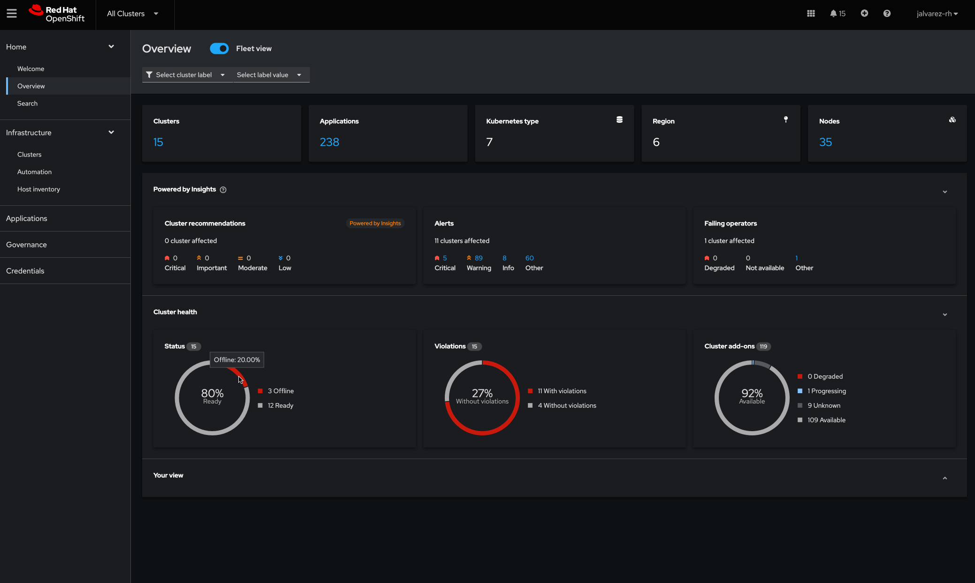
Fleet health monitoring
Multicluster observability for fleet health and optimization
Proactively monitoring cluster health and performance
Sort, filter, and scan individual clusters and user workloads in addition to aggregated multiclusters with Grafana.
Use the open source Thanos project for scalable metrics collection with long-term data retention.
Get health metrics for OpenShift clusters and non-OpenShift clusters—such as EKS, GKE, AKS, and IKS—in the many out-of-the-box Grafana dashboards.

Slide 24
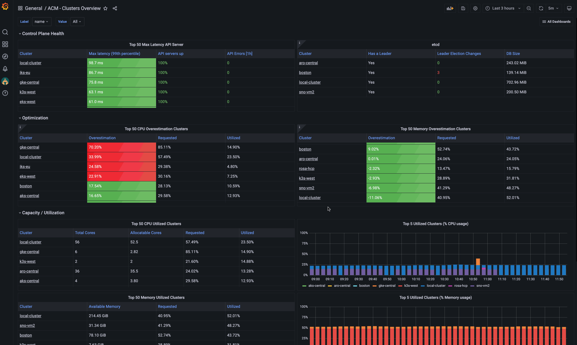
Customized metrics and dashboards
Multicluster observability for fleet health and optimization
Monitor metrics relevant to your organization
Customize Grafana dashboards based on metrics you define and predefined metrics.
Define service-level objectives (SLOs) on a cluster or the platform services, measure the performance against them, and dynamically adjust for deeper collection during critical events when root cause analysis requires it.

Slide 25
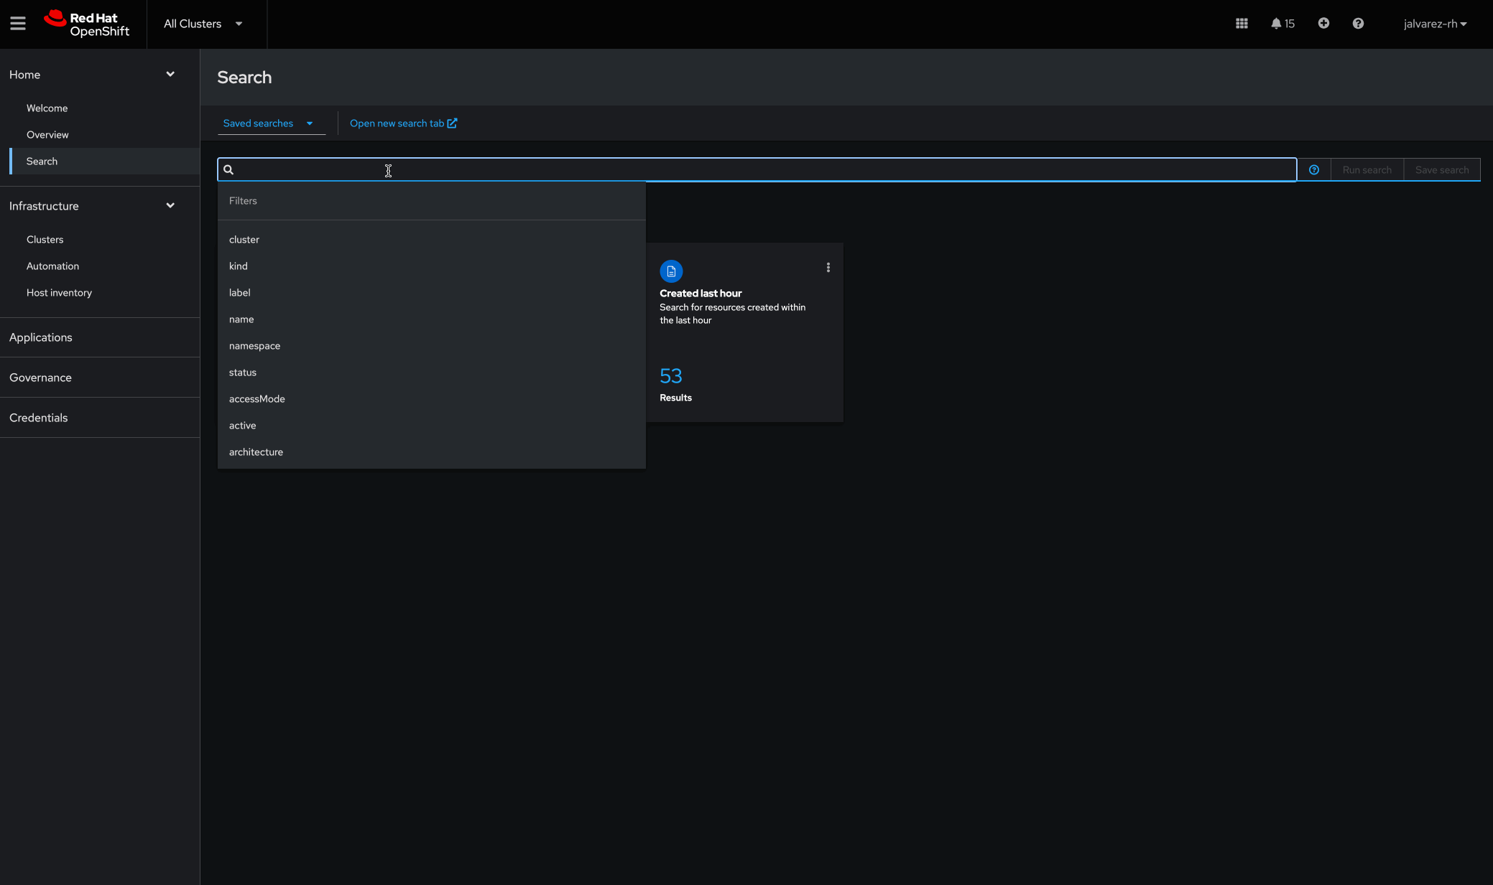
Dynamic search
Multicluster observability for fleet health and optimization
More easily identify and remediate issues
Use the graphical console or the API to identify, isolate, and resolve issues affecting distributed workloads including those deployed on Red Hat OpenShift virtualization VMs.
Application SREs can view application resource YAML and fetch logs from deployments in real time, assisting in mean time to resolution and problem determination.
Improved controls with configurable data collection provides opportunities for high-scale environments and centralized controls to limit what gets collected from the managed clusters.

Slide 26
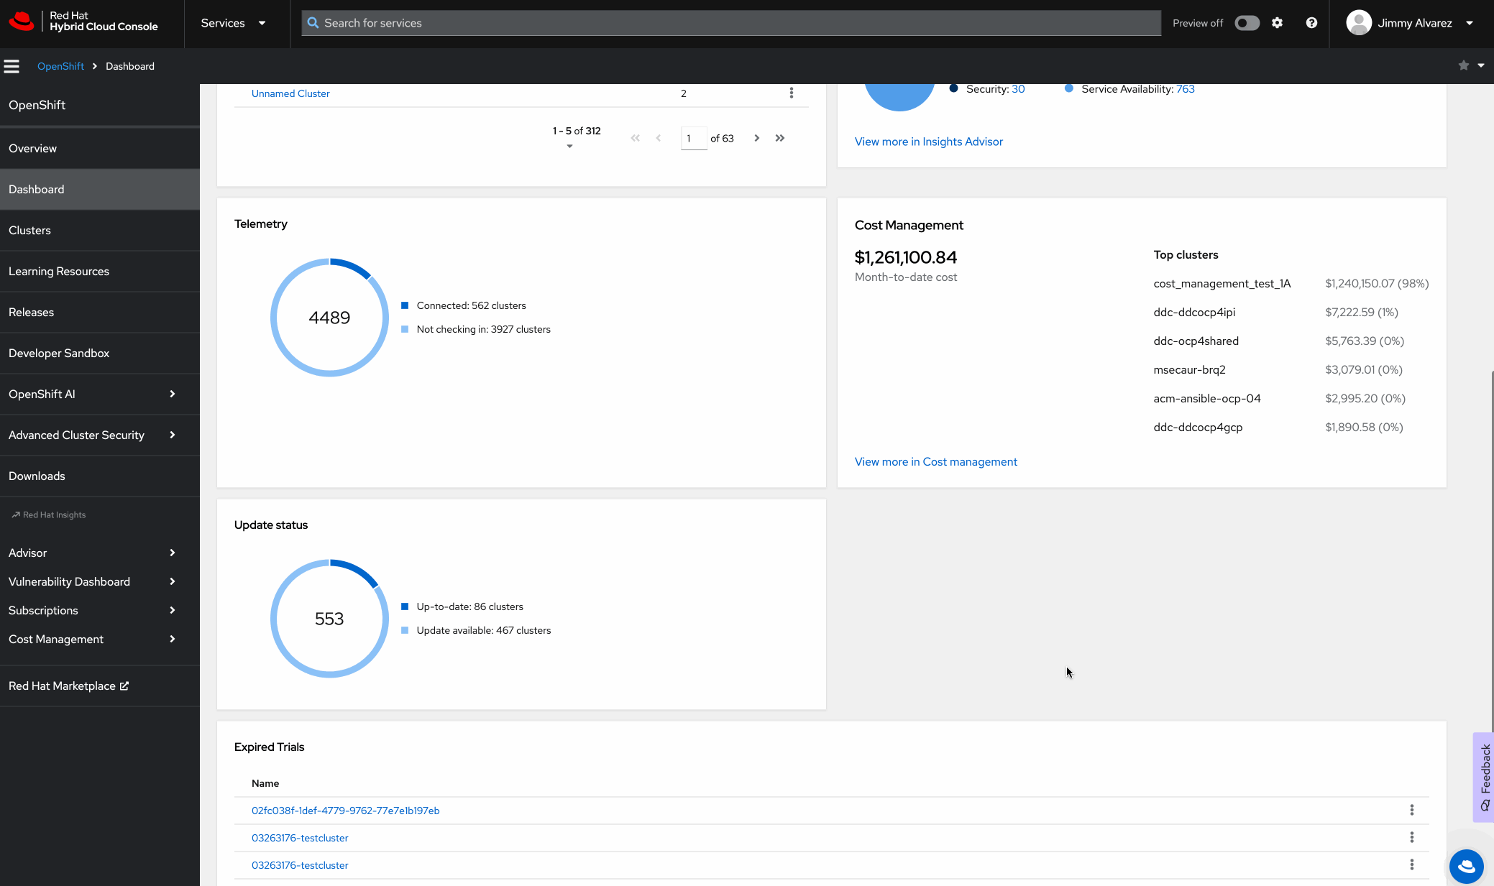
Analytics through Red Hat Insights for Red Hat OpenShift
Multicluster observability for fleet health and optimization
Boost operational efficiency and reliability
Identifies availability, performance, stability, and security risk analysis
Analyzes remote health data (Insights + Telemetry) data to provide recommendations
Recommendations cover the infrastructure and service layers of OpenShift
Provides predictive findings and prescriptive information on how to resolve
Integrates with notifications, OpenShift web console and Advanced Cluster Manager

Slide 27
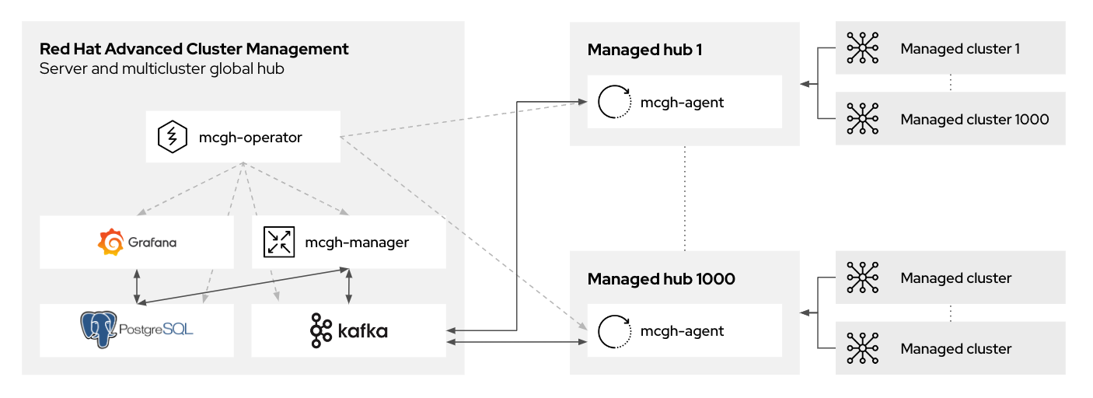
Global Hub
Multicluster observability for fleet health and optimization
A centralized policy compliance view across multiple hubs
The multicluster global hub operator is the root operator which pulls in all things needed. It is used to deploy all required components for multicluster management.
Multicluster global hub manager in the global hub cluster is used to persist the data into the postgreSQL.
Multicluster global hub agent in the managed hub clusters is responsible to sync-up the data between the global cluster hub and the managed hub clusters.
Policy-view and search functionality allows for reporting on policy compliance status and trends, inventorying all managed hubs and clusters, and detecting/alerting irregular policy behavior.

Slide 28
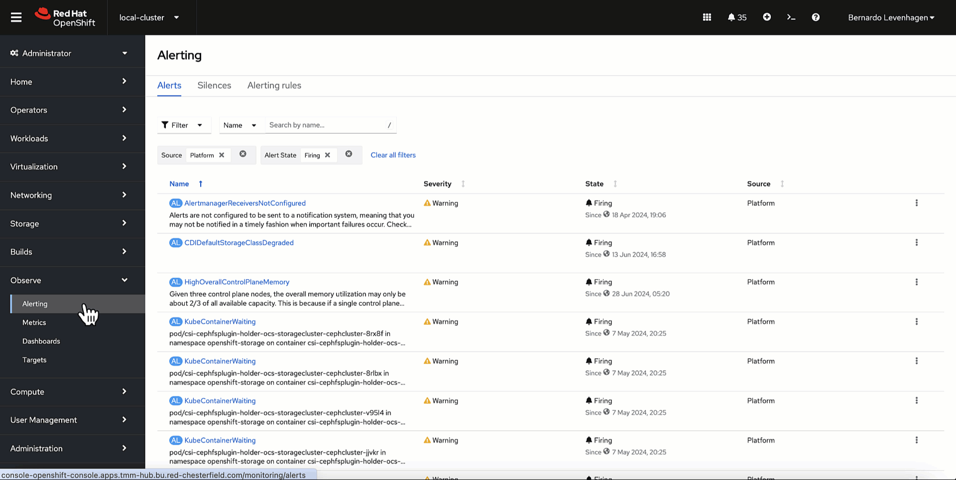
Automatic alert forwarding from managed clusters
Multicluster observability for fleet health and optimization
Configure common integrations in Red Hat Advanced Cluster Management
Respond and troubleshoot more easily by getting centralized alerts of cluster health metrics and all of your policy violations sent into your third-party tools, such as Slack and PagerDuty.
With centralized alerting, users can identify alert patterns and administrators can review the alert information and configure silencing/inhibiting for each individual cluster in the hub.

Slide 29
Unified multicluster
life cycle management
Use case
Red Hat Advanced Cluster Management for Kubernetes

Slide 30


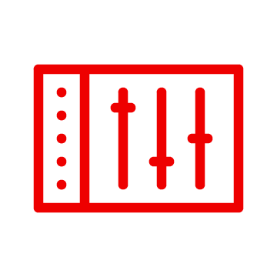



Unify multicluster life cycle management
Unified multicluster life cycle management
Reliably and consistently manage clusters at scale
Cluster life cycle management Create, upgrade, and manage Kubernetes clusters
Multicluster networking with Submariner Reduce the complexity of deploying across clusters
Cloud providers supported Create clusters on all major public cloud platforms
Hosted control planes Deploy containerized control planes at scale to reduce cost and footprint
Enhanced cluster life cycle management Group clusters into sets to define access controls
Central infrastructure management for bare-metal deployments Access bare-metal resources to provision OpenShift clusters
Red Hat Ansible® Automation Platform integration
Create Ansible-native access across your Kubernetes fleet
Cluster discovery service
Quickly discovery and onboard existing OpenShift clusters

Slide 31
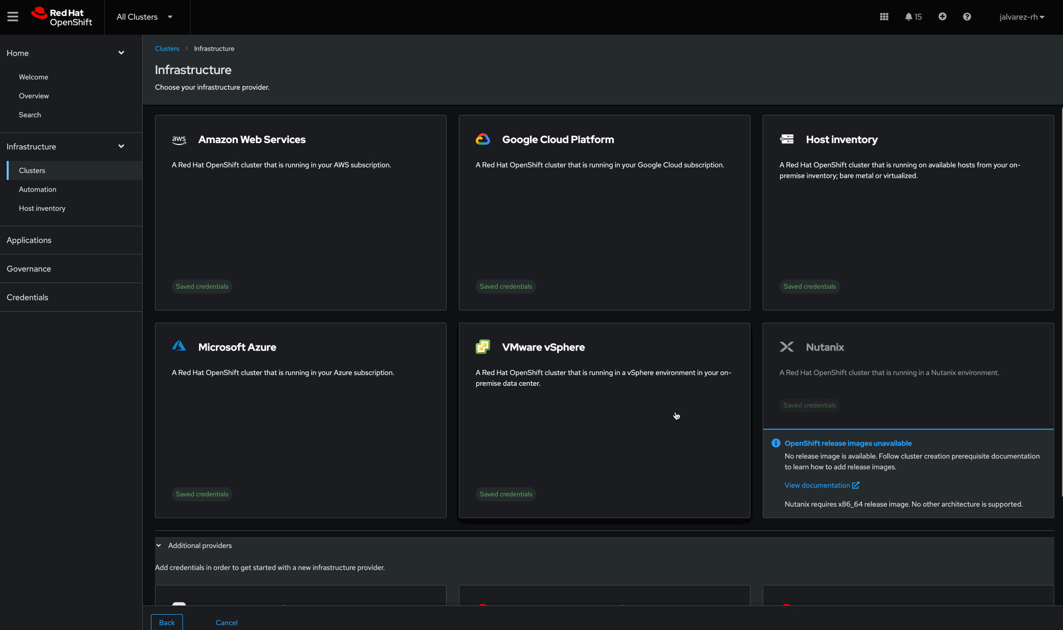
Cluster life cycle management
Unified multicluster life cycle management
Create, upgrade, and manage Kubernetes clusters
Gain Day 1 experience with cluster life cycle management using Advanced Cluster Management provisioning capabilities for every platform.
Create and upgrade new Red Hat OpenShift clusters, or import existing OpenShift and managed Kubernetes clusters, using Red Hat Advanced Cluster Management console.

Slide 32
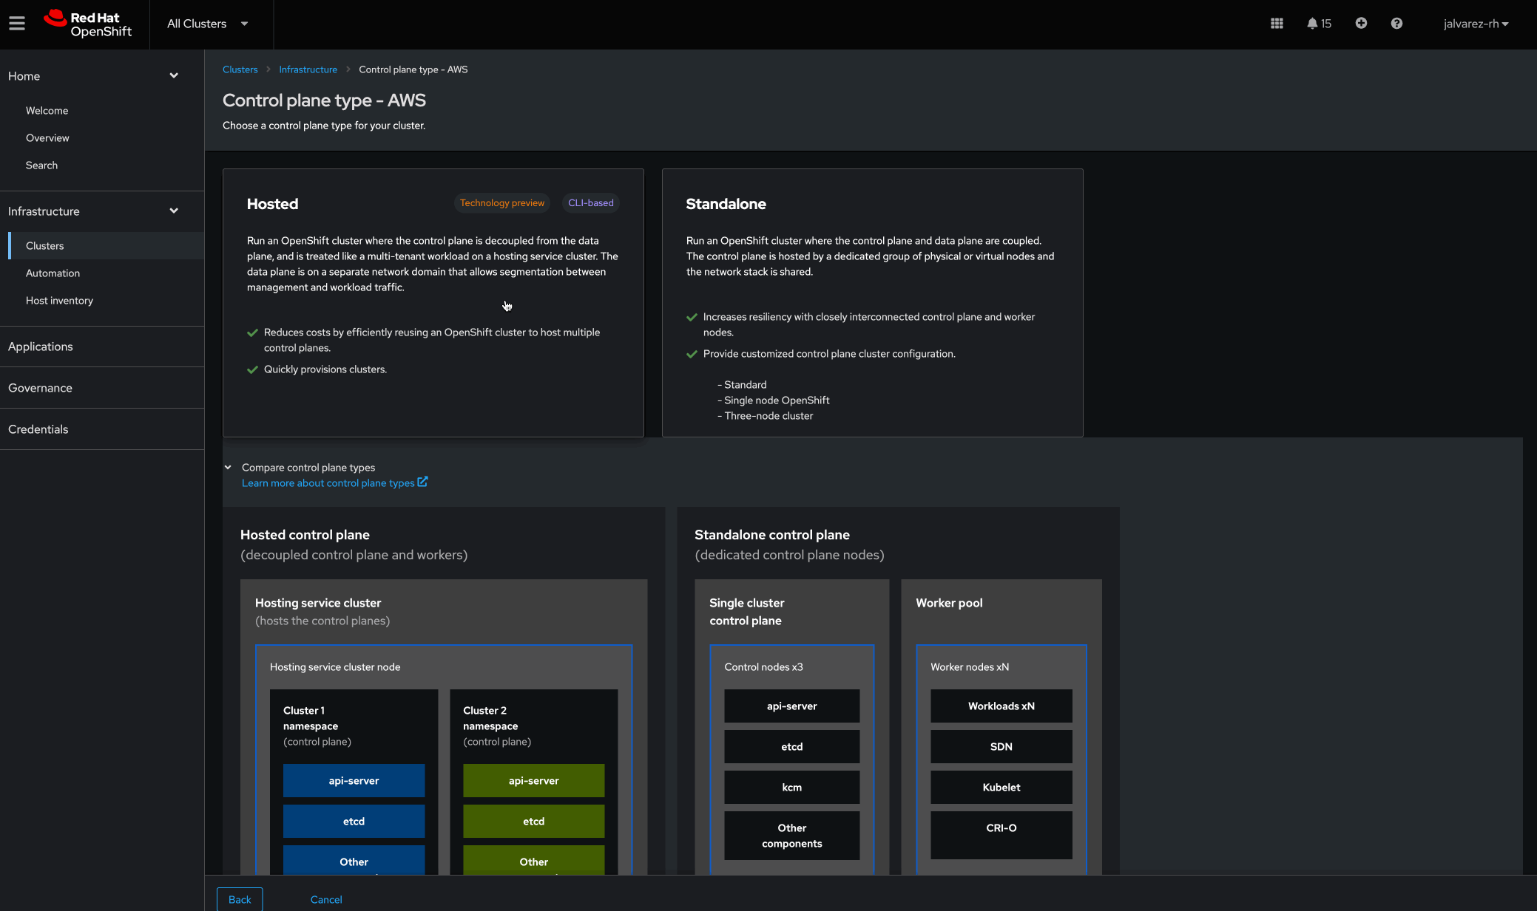
Cloud providers supported
Unified multicluster life cycle management
Create clusters on all major public cloud platforms
Red Hat Advanced Cluster Management supports the creation of OpenShift clusters on:
Amazon AWS
Microsoft Azure
Google Cloud Platform
Microsoft Azure Government
AWS GovCloud
ROSA HCP (dev preview fall ‘24)
Bare metal (including Nutanix)
Red Hat OpenStack Platform
VMware vSphere
Hosted control planes (AWS, bare metal, KubeVirt)
View the support matrix

Slide 33
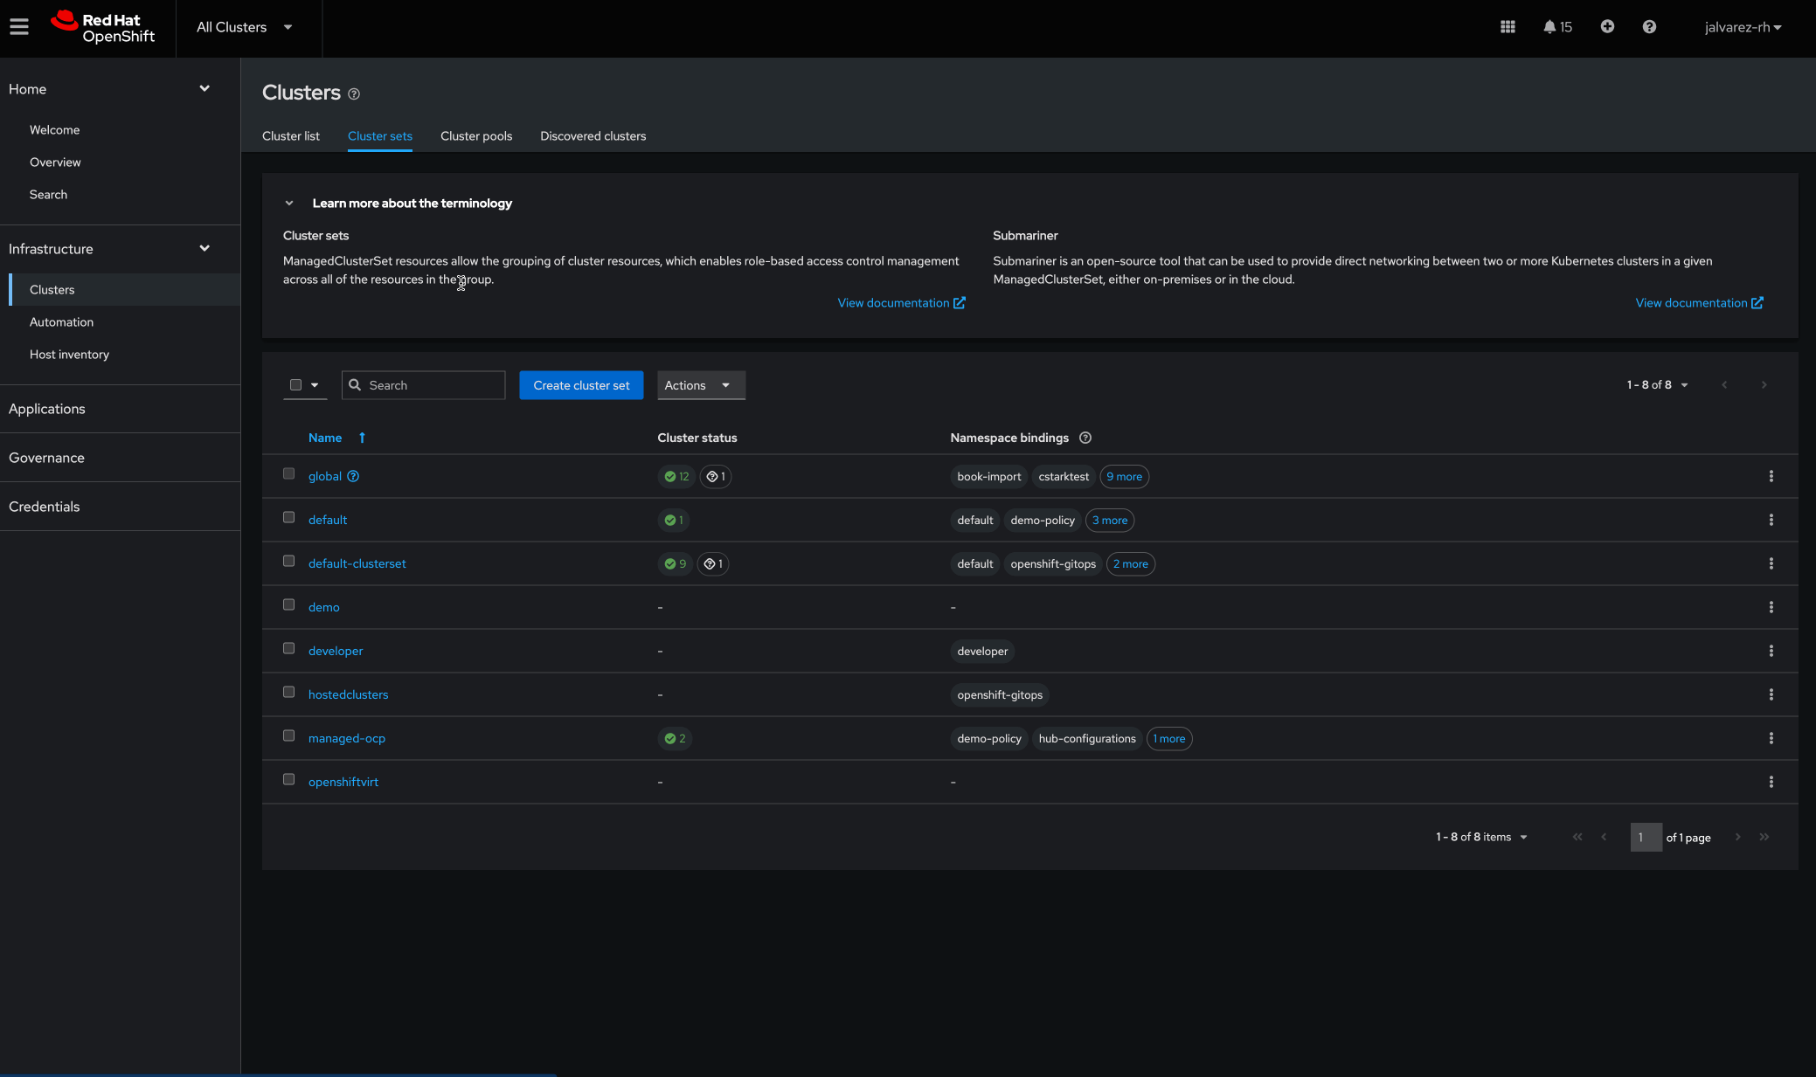
Enhanced cluster life cycle management
Unified multicluster life cycle management
Deploy clusters in less time
Take advantage of features such as worker pool scaling with autoscale configuration, cluster hibernation and resume, on-demand cluster provisioning via cluster pools (tech preview) to help deploy clusters in less time.
Group clusters into cluster sets to more clearly define access controls.

Slide 34

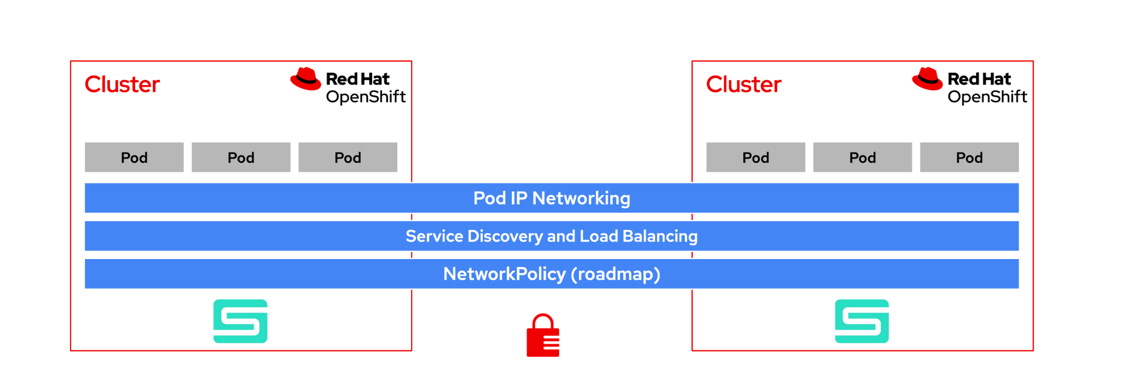
Multicluster networking with Submariner
Unified multicluster life cycle management
Reduce the complexity of connecting applications across clusters
Red Hat OpenShift Cluster
Red Hat OpenShift Cluster
Pod-to-pod and pod-to-service routing with native performance Eliminates the need for proxies, external load-balancers or ingress for east/west traffic
Deploy services across clusters Beyond connectivity, also implements cross-cluster service discovery (DNS) with service failover and load balancing across clusters
Enhanced security All traffic flow between clusters is encrypted by default; also offers seamless integration with NetworkPolicy (roadmap)
Dataplane transparency Compatible with different cloud providers and network (CNI) plugins
Pod
Pod
Pod
Pod
Pod
Pod
Pod IP networking
Service discovery and load balancing
Network policy (roadmap)
Multi-cluster networking supports RHACM's disaster recovery mechanisms. Regional-DR data replication runs on top of the connection provided by Submariner.

Slide 35
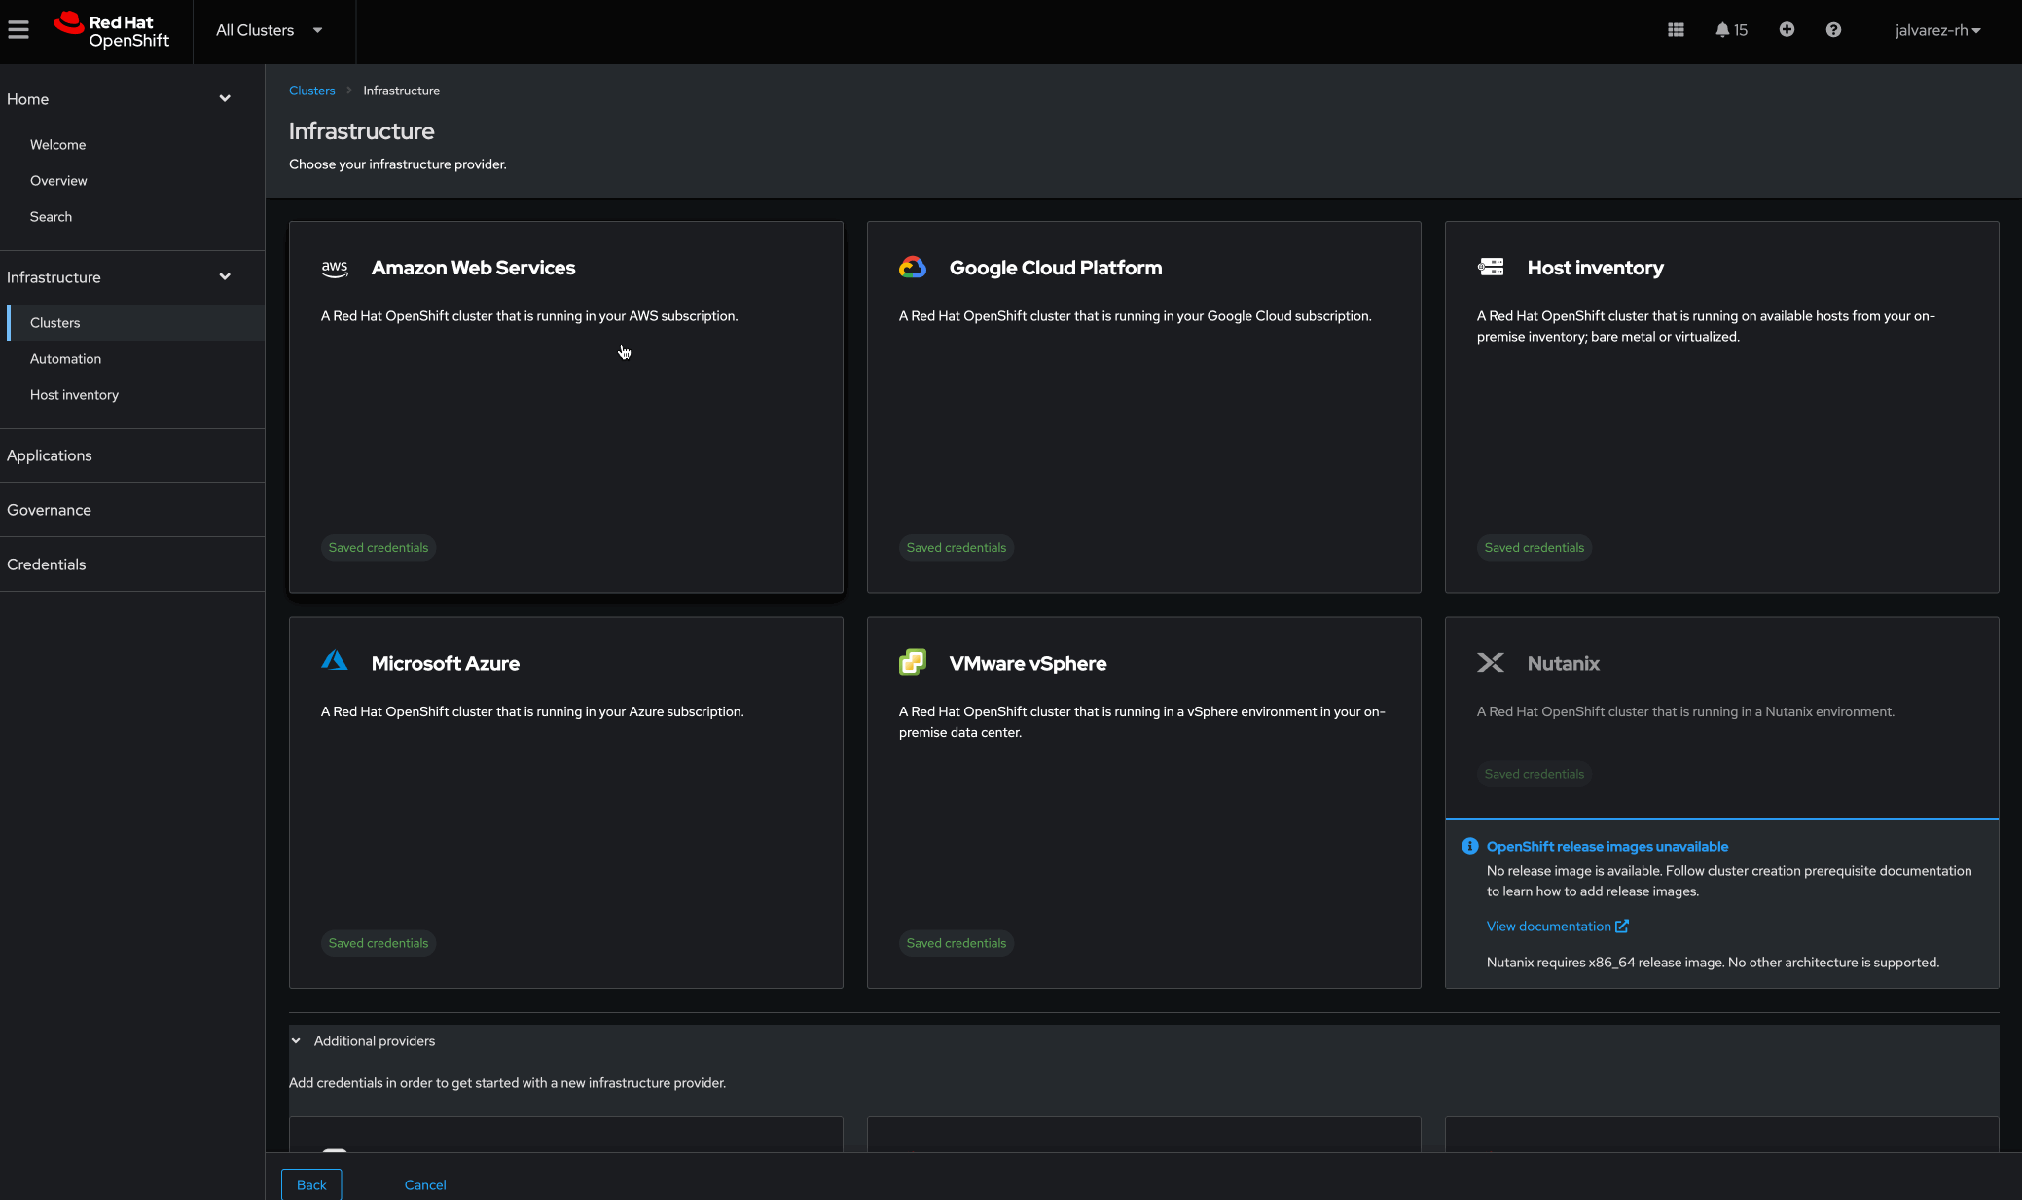
Hosted control planes
Unified multicluster life cycle management
Host and provision containerized control planes at scale to reduce cost and footprint
Hosted control planes are decoupled management planes that enable consolidated control and management of core control plane components.
Run control planes on smaller nodes resulting in more affordable clusters.
Achieve better isolation by decoupling the control plane, which strengthens security boundaries between management and workloads.
Notes:
Hosted Control Planes (HCP) is based on the upstream Red Hat project HyperShift which can be thought of as a middleware for hosting OpenShift control planes at scale. HyperShift solves for cost and time to provision, as well as strong separation of concerns between management and workloads.

Slide 36
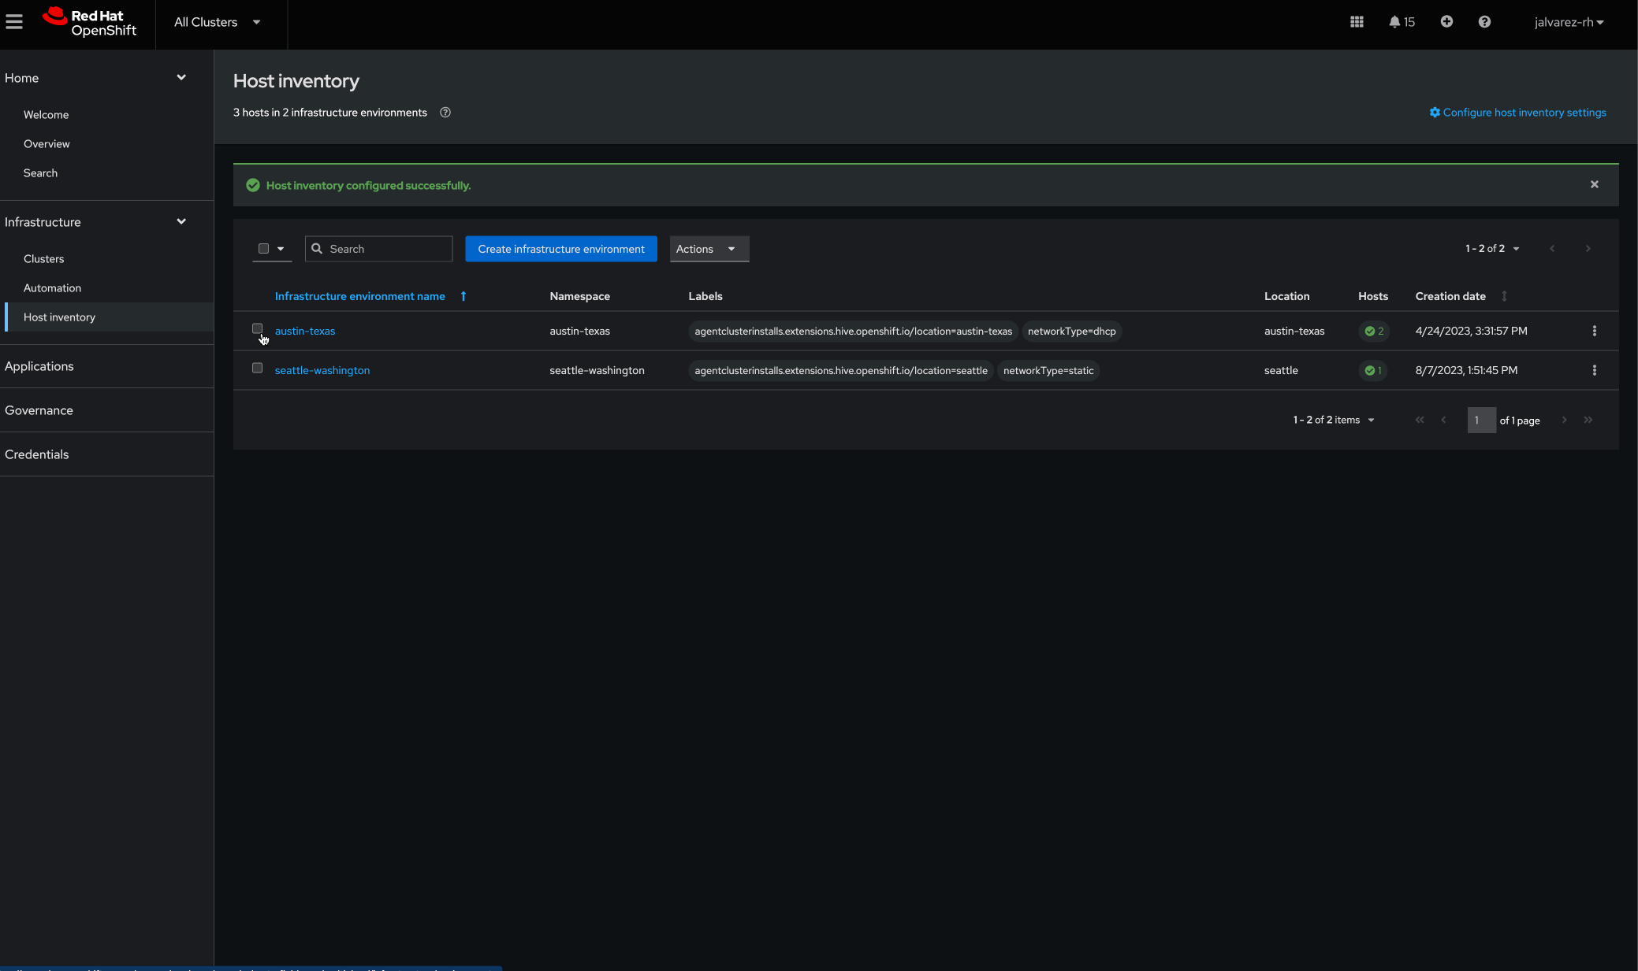
Central infrastructure management for bare-metal deployments
Unified multicluster life cycle management
Access bare-metal infrastructure resources to provision OpenShift clusters
Use a self-service model that allows infrastructure owners to provide developers access to bare-metal infrastructure resources to provision OpenShift clusters.
Use the infrastructure environments allowing operators to readily maintain your bare-metal host inventory.

Slide 37
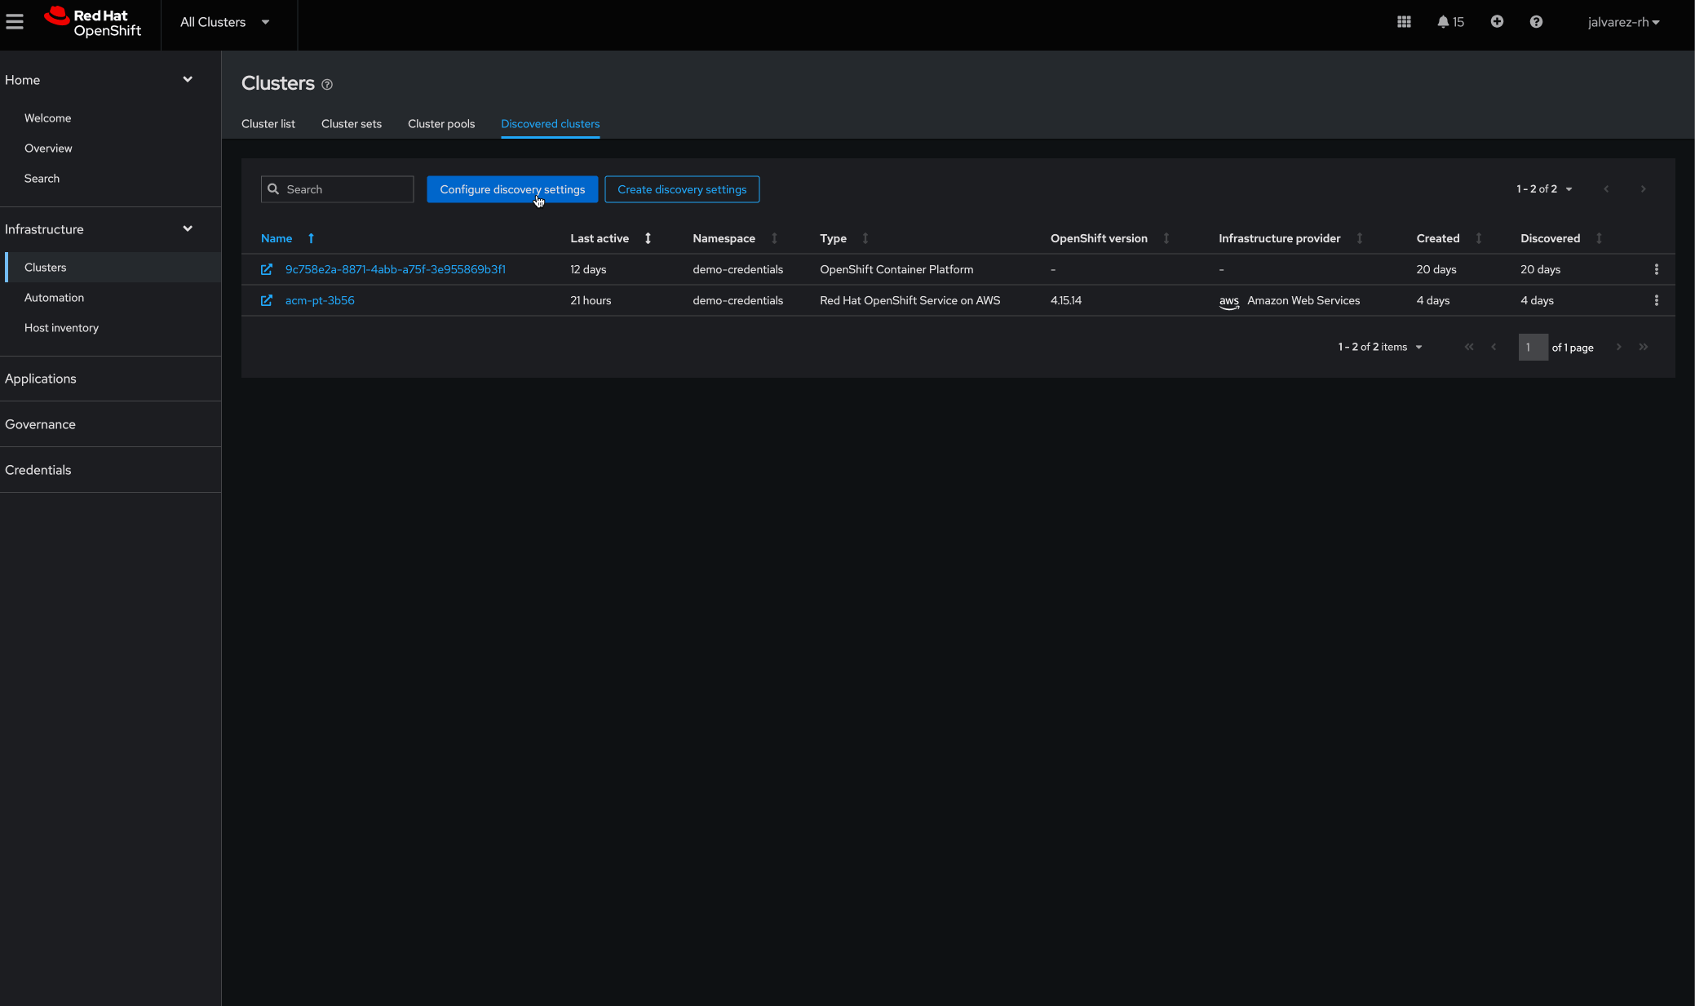
Cluster discovery service
Unified multicluster life cycle management
Quickly discovery and onboard existing OpenShift clusters
Discover OpenShift 4 clusters that are available from OpenShift Cluster Manager.
After you discover clusters, you can import clusters that appear in the “Discovered clusters” tab of the console.
The discovery services uses the Discover Operator for back-end and console usage.

Slide 38
Policy-based governance
Use case
Red Hat Advanced Cluster Management for Kubernetes

Slide 39

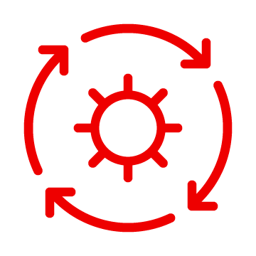

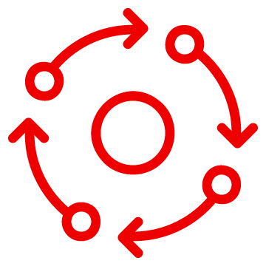




Policy-based governance
Policy-based governance, risk, and compliance
Automatically monitor and ensure desired best practices configuration state
Out-of-the-box policy templates Implement and deploy policy-based governance
More efficient policy management through policy sets Group policies for specific purposes
Governance and risk dashboard Manage policy violations across workloads
Integration with Red Hat OpenShift Platform Plus policy set Deploy Compliance Operator at scale across your fleet
Customized visualization of policy violations View what is most-affected with a managed user interface
Hub-side policy templating Reduce the number of policies for high-scale management scenarios
Integration with Gatekeeper and Open Policy Agent (OPA)
Initiate Gatekeeper controls across your fleet
Policy generator Allow policies to be auto-generated and deployed

Slide 40
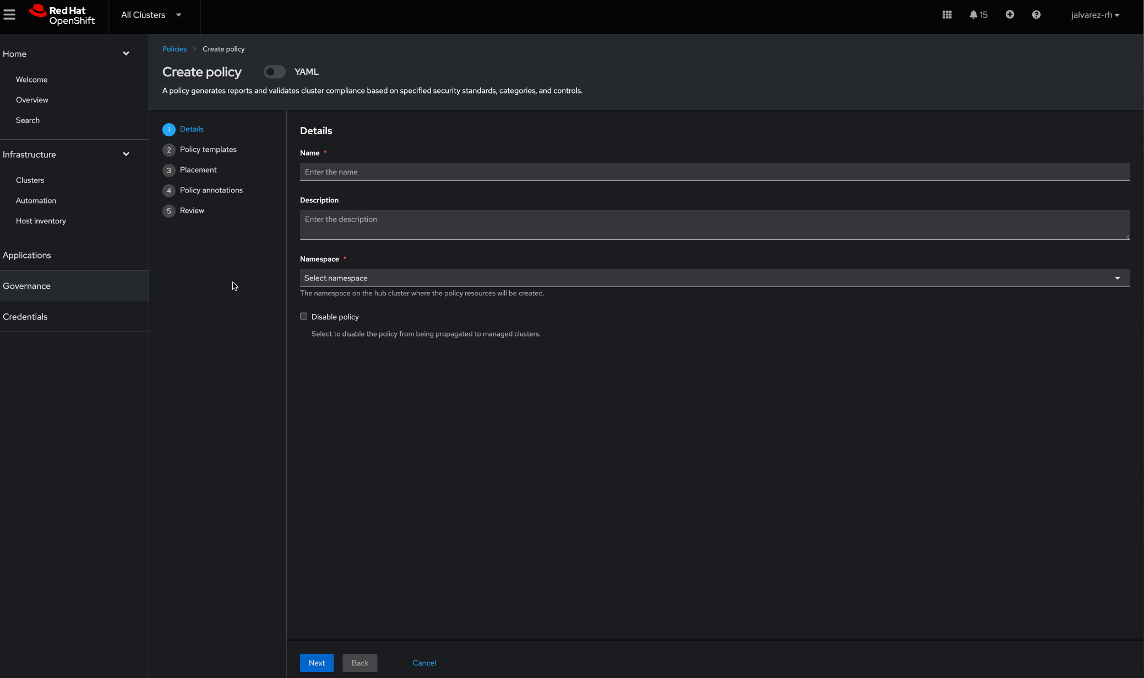
Out-of-the-box policy templates
Policy-based governance, risk, and compliance
Templates for managing cluster configurations
Use prebuilt policy templates to enforce policy on Kubernetes configuration (e.g., etcd encryption), identity and access management (IAM), certificate management, and deploy and configure operators, such as Compliance Operator and Gatekeeper/Open Policy Agent (OPA) across your clusters.
Implement policy-based governance via GitOps to meet internal and external standards, using the open source policy collection repository.

Slide 41
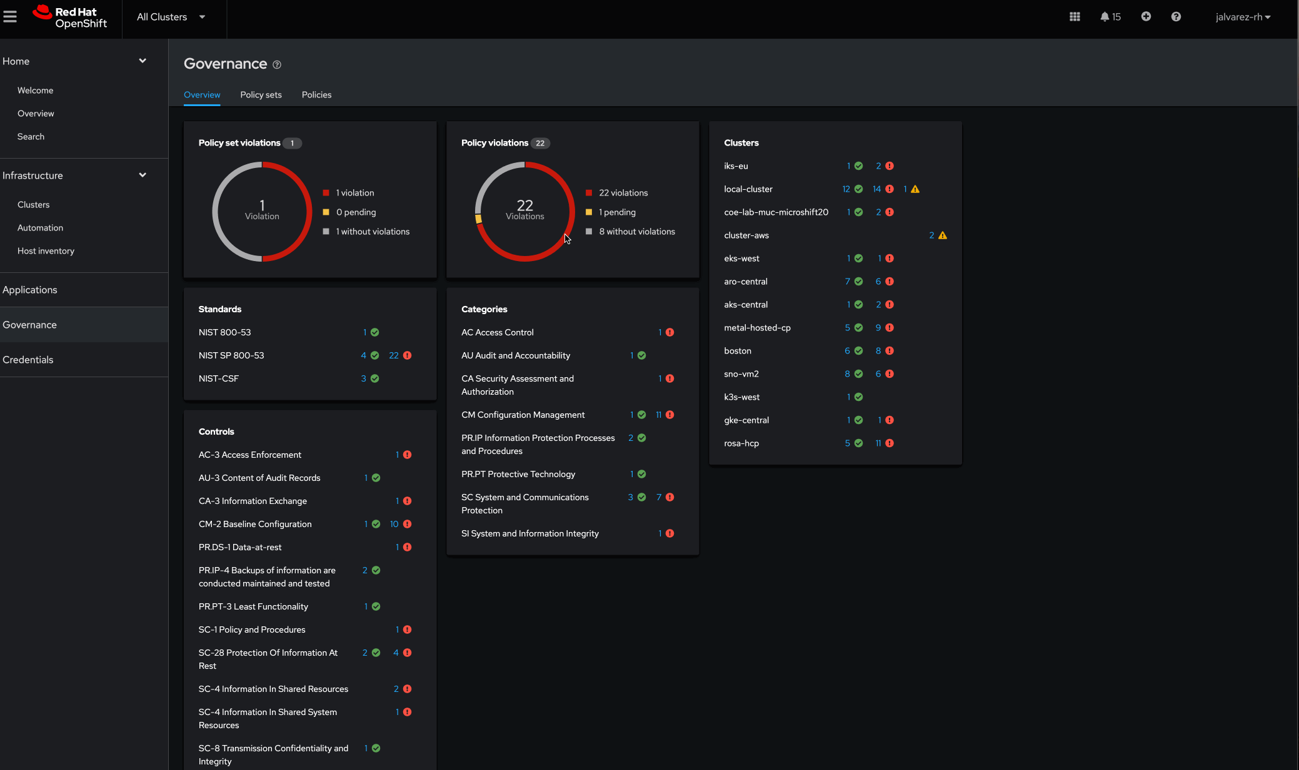
Governance dashboard
Policy-based governance, risk, and compliance
Manage policy violations across workloads
Use the governance dashboard to view and manage policy violations in all of your clusters and applications. Get details on violation history.
Drill down into violation details by centrally accessing details from managed clusters from the Red Hat Advanced Cluster Management hub.

Slide 42
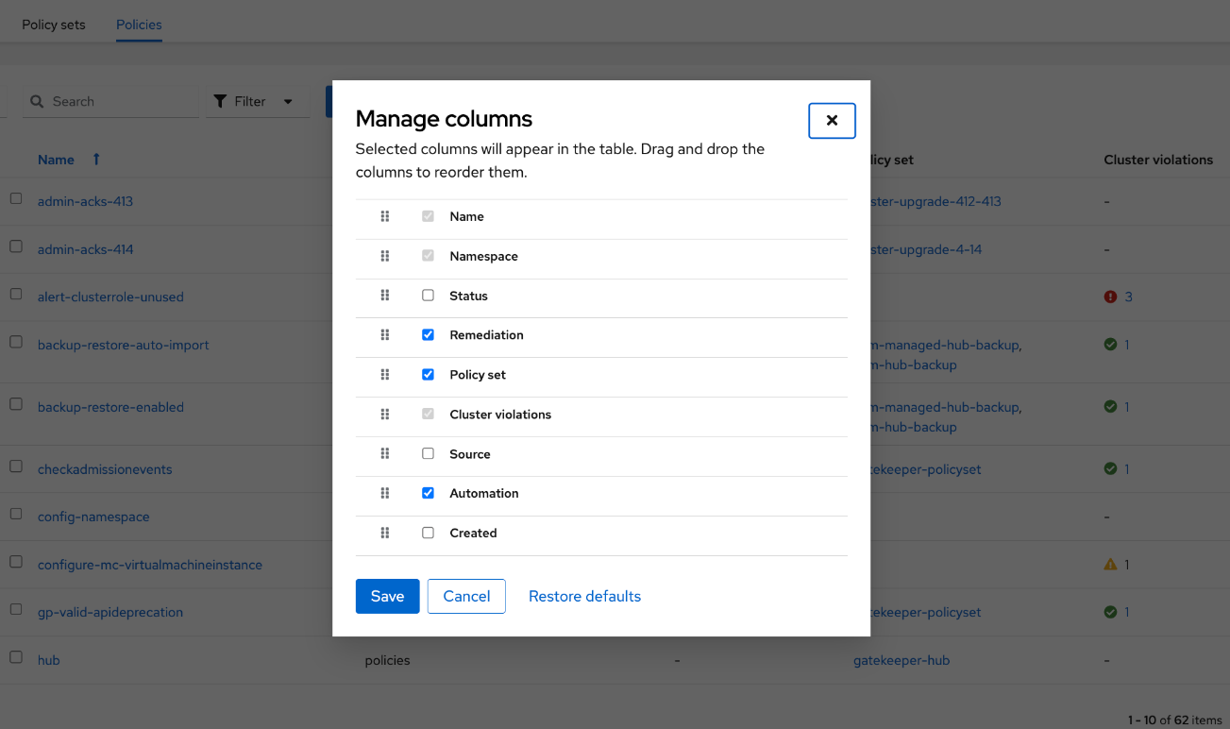
Customized visualization of policy violations
Policy-based governance, risk, and compliance
See what what is being impacted the most with a managed user interface
Customize for various compliance standards, governance dashboard views, and most-affected controls for specific standards.

Slide 43
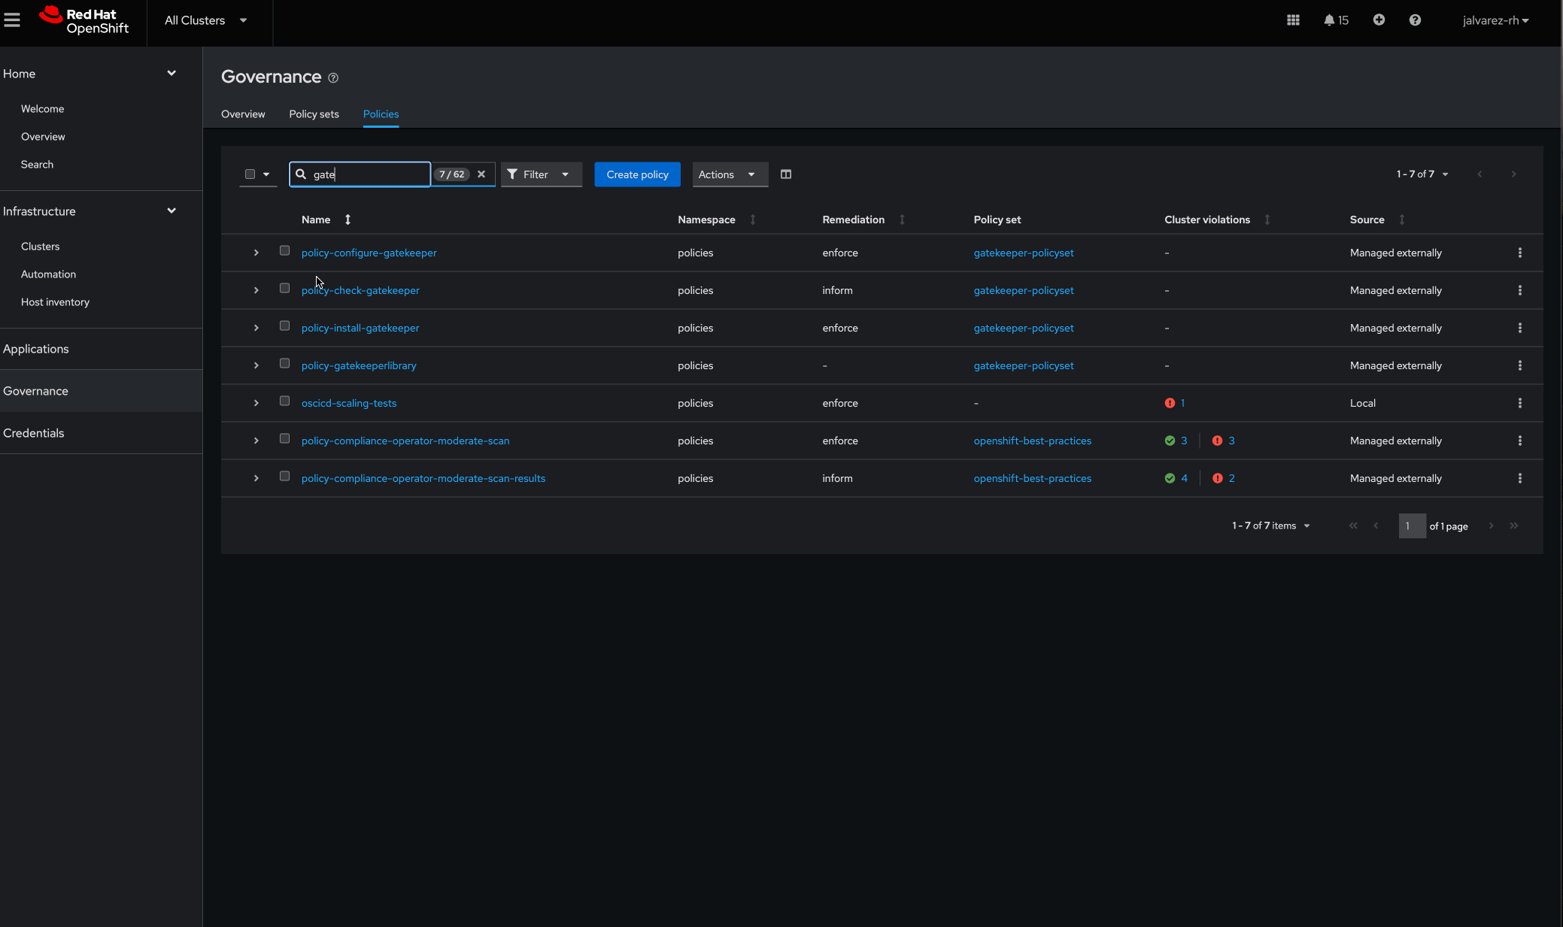
Integration with Gatekeeper and Open Policy Agent (OPA)
Policy-based governance, risk, and compliance
Initiate Gatekeeper controls across your fleet
Get a fully supported Gatekeeper and OPA operator that supports deployment of the Gatekeeper operator to your fleet, using compliance policy.
Initiate Gatekeeper controls across your fleet to enforce various OPA policies.
Centrally view and drill down into violations for all of your Gatekeeper and OPA policies.

Slide 44
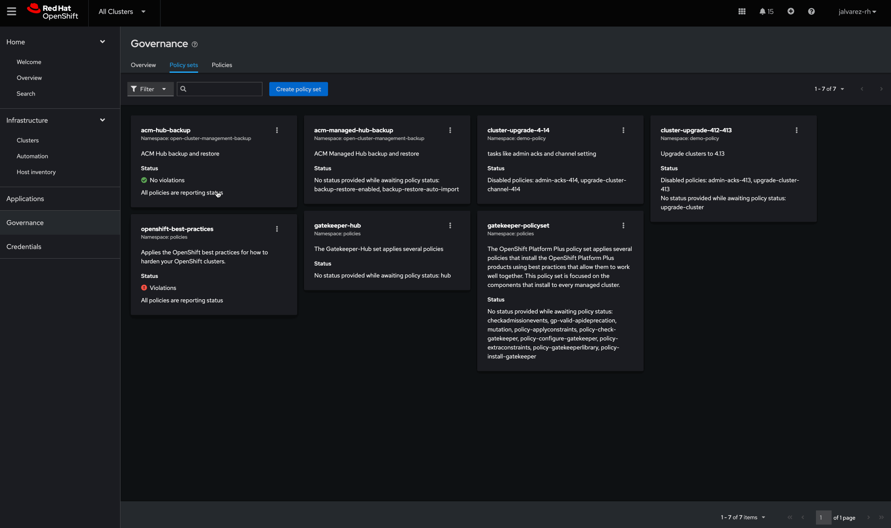
More efficient policy management through policy sets
Policy-based governance, risk, and compliance
Group policies for specific purposes to manage clusters at scale
This ensures an enhanced user-friendly experience of organizing, managing, and enforcing policies or policy sets for clusters at scale. Includes:
Preconfigured policy sets are available via GitOps as a starting point to use this feature.
Open, extensible policy framework and policy collection repository
Integration with Kyverno policy sets
Red Hat OpenShift Platform Plus policy set
Simplified management and edge scalability using templatized policies

Slide 45
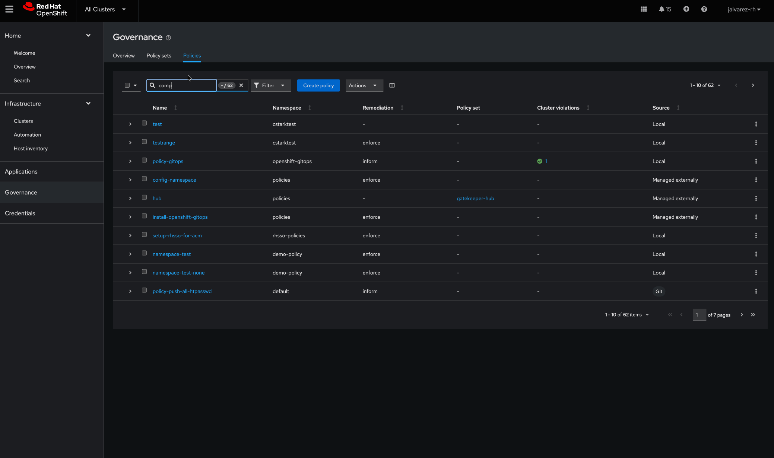
Integration with Red Hat OpenShift Platform Plus policy set
Policy-based governance, risk, and compliance
Deploy Compliance Operator at scale across your fleet
The OpenShift Plus policy set applies multiple policies that are set to install Red Hat OpenShift Platform Plus products.
Use it to deploy Compliance Operator at scale across your fleet, using Red Hat Advanced Cluster Management to enforce various security profiles for compliance standards, such as the E8 Essential scan.
Centrally view and drill down into violations for clusters violating your governance policies.

Slide 46
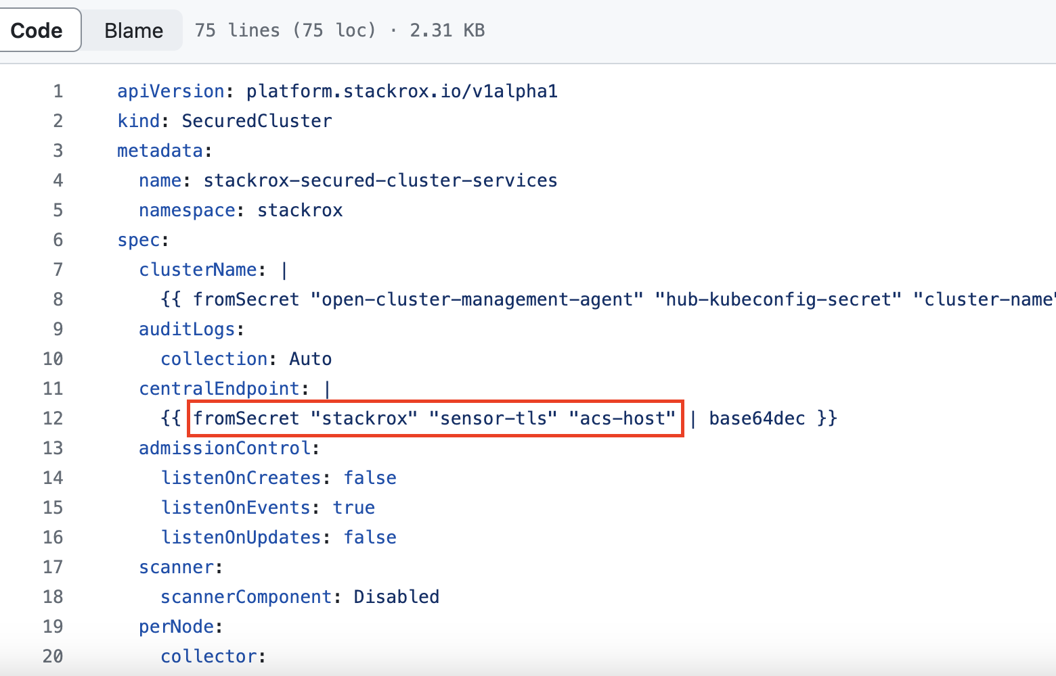
Hub-side policy templating
Policy-based governance, risk, and compliance
Reduce the number of policies for high-scale management scenarios
Reduce the number of policies for high-scale management scenarios by allowing them to refer to data from resources on the hub or in the managed cluster itself.
The policy is dynamically updated according to latest changes in the source data.

Slide 47
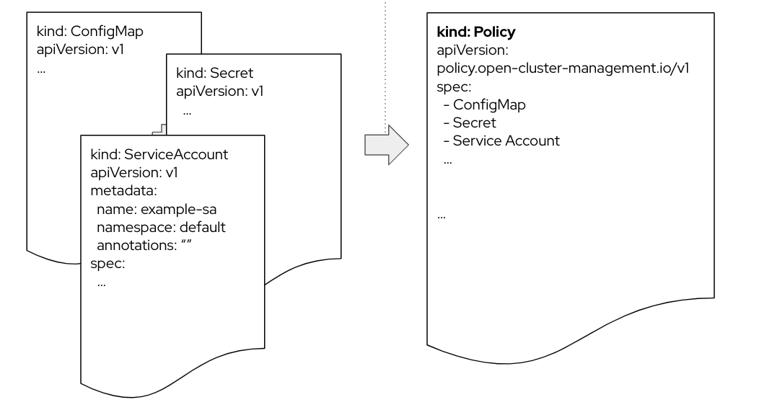
Policy generator
Policy-based governance, risk, and compliance
Allow policies to be auto-generated and deployed
Allow policies to be auto-generated and deployed via OpenShift GitOps from existing Kubernetes configuration, Gatekeeper, and Kyverno policies.
Take advantage of collaborative upstream policy contributions using the policy collection repository.

Slide 48
Advanced application life cycle management
Use case
Red Hat Advanced Cluster Management for Kubernetes

Slide 49


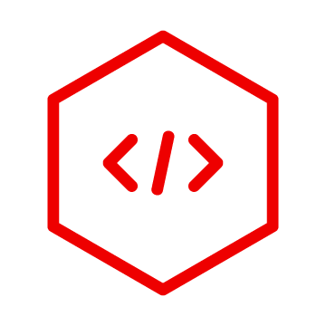
Advanced application life cycle management
Advanced application life cycle management
Construct and deploy applications and updates automatically and at scale
Application topology view Get wider visibility and readily view the health of pods
Application builder Create intuitive applications, using a form-based input
Workload placement(s) Deploy workloads across your fleet or only to specific clusters
OpenShift GitOps/Argo CD integration Automatically deliver content as clusters

Slide 50
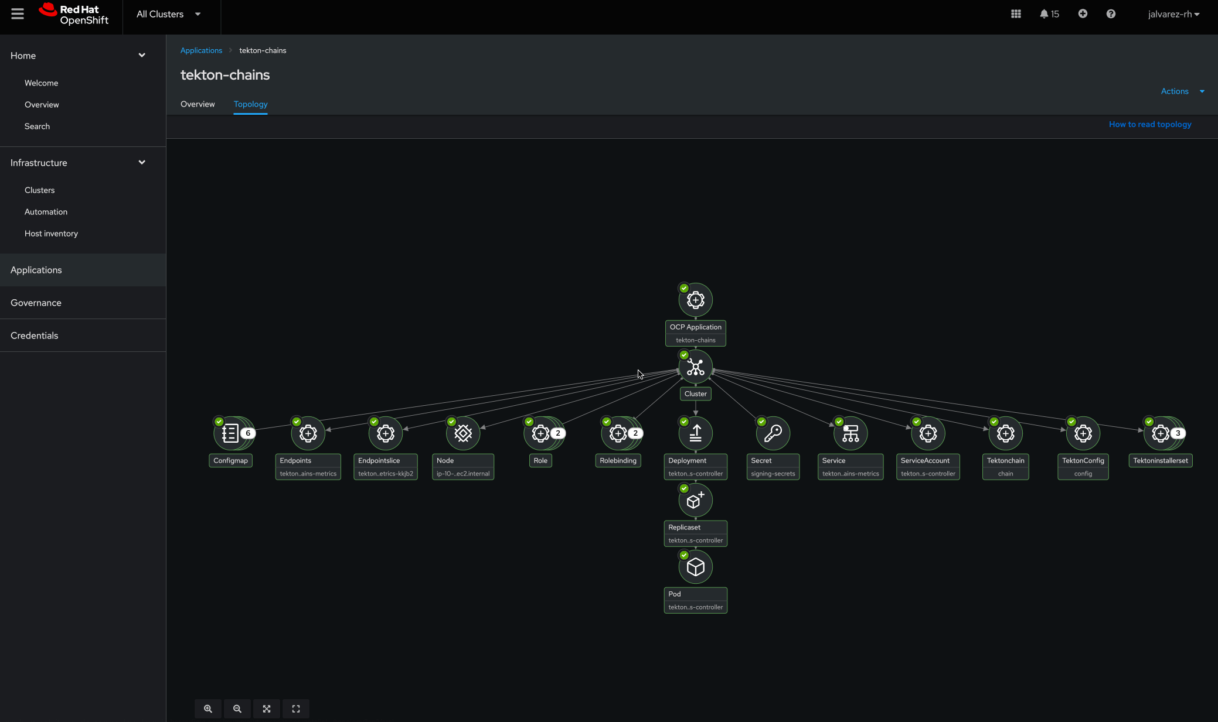
Application topology view
Advanced application life cycle management
Get wider visibility and readily view the health of pods
Get wider visibility of the application topology and readily view the health of service endpoints and pods with all of the connected dependencies like image versions, associated placement rules, Kubernetes resources, and ConfigMaps, no matter if your application was created within Red Hat Advanced Cluster Management, Red Hat OpenShift, or GitOps tools like ArgoCD and Flux.

Slide 51
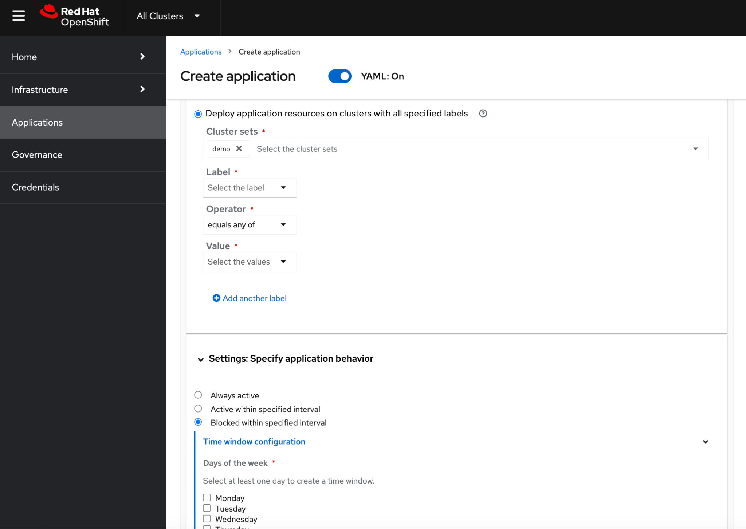
Workload placement(s)
Advanced application life cycle management
Deploy workloads across your fleet or only to specific clusters
Rapidly deploy workloads across your fleet, or only to specific clusters, on the basis of placement rule definitions and time windows to control when and where your applications are being deployed.
Based on the Placement API from Open Cluster Management

Slide 52
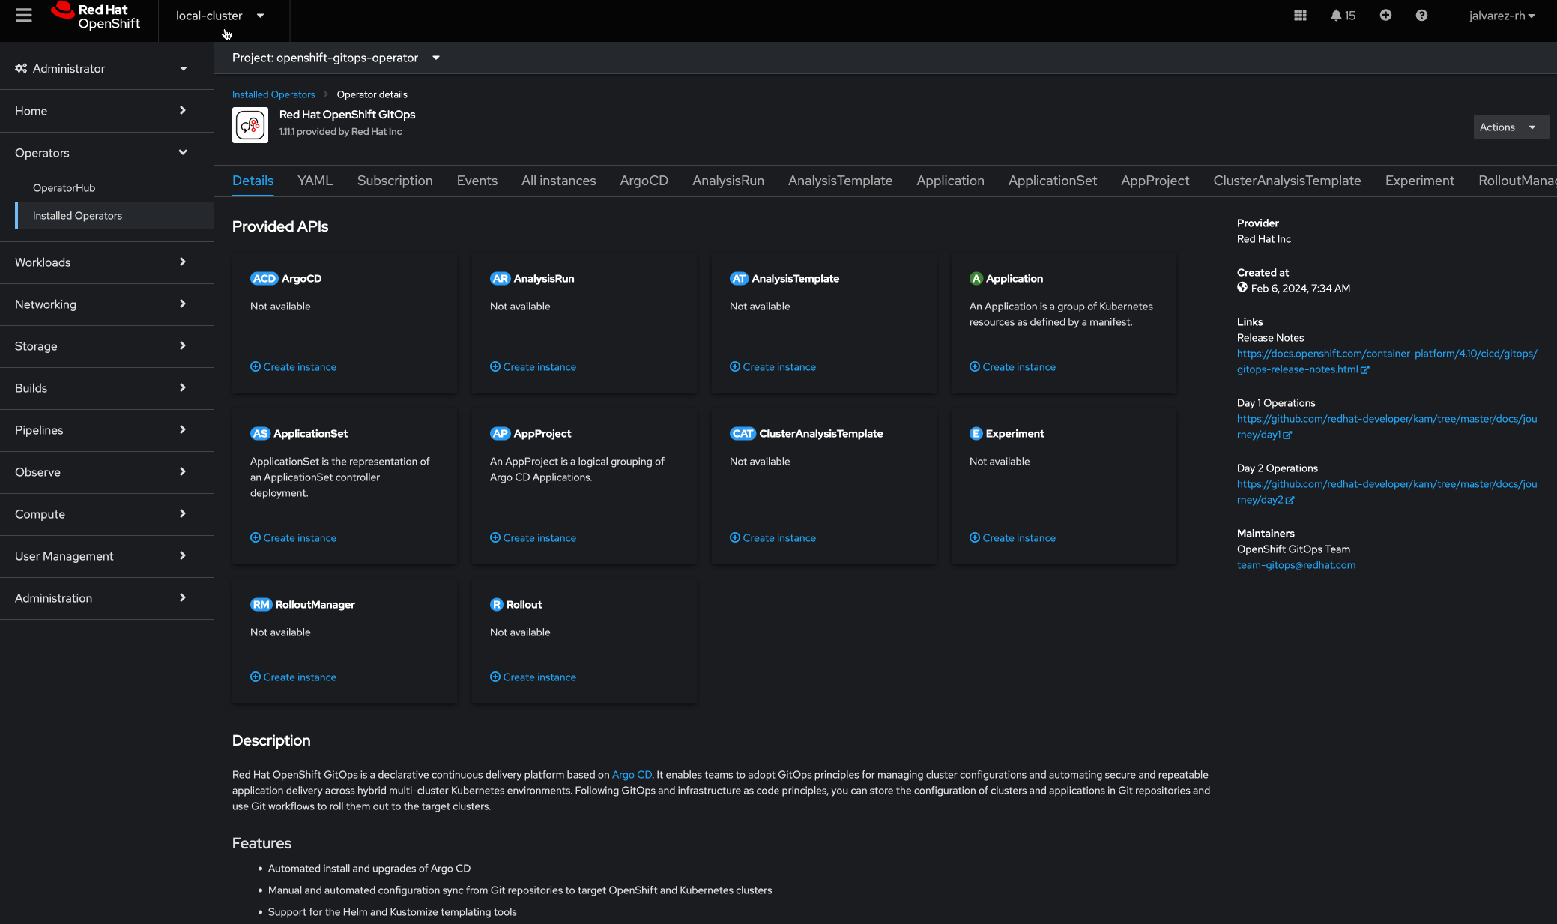
OpenShift GitOps/Argo CD integration
Advanced application life cycle management
Automatically deliver content as clusters
Use Red Hat Advanced Cluster Management (RHACM) to allow OpenShift GitOps/Argo CD to automatically deliver content as clusters come online or get imported.
RHACM policies work in tandem with Argo CD to make sure compliance and configuration are managed and maintained at scale for tighter CI/CD alignment.
View and troubleshoot applications deployed by Argo CD in the RHACM application topology view.
Create application set objects for your clusters, registered within Argo, from RHACM console.

Slide 53
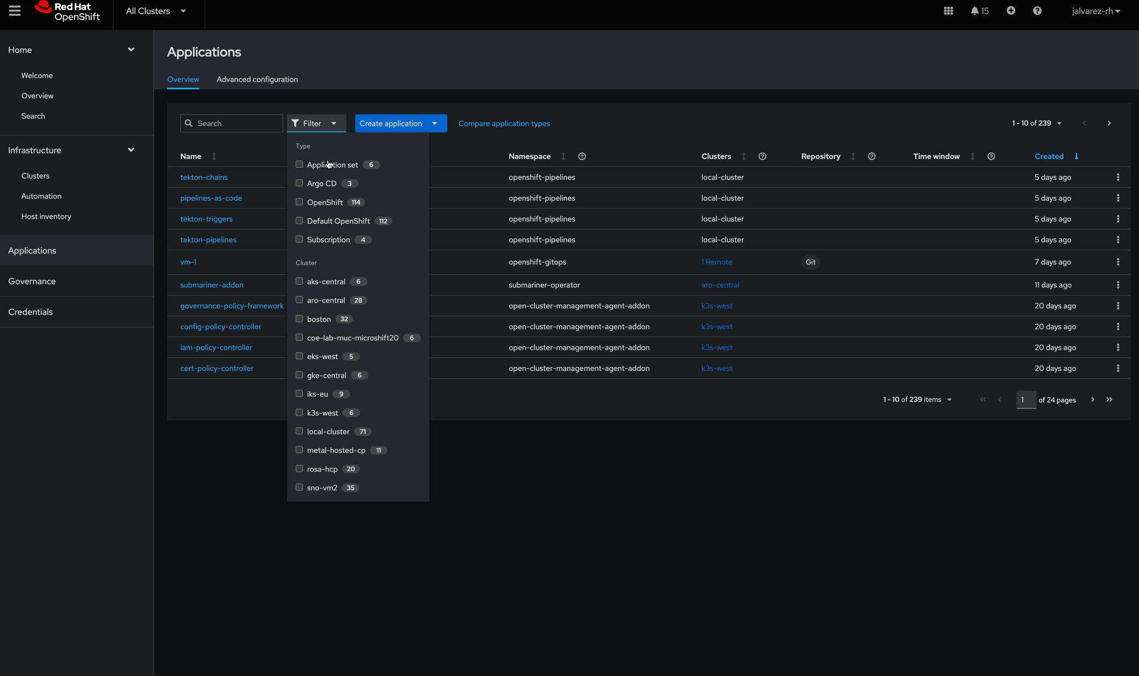
Application builder
Advanced application life cycle management
Create intuitive applications, using a form-based input
Create intuitive applications, using a form-based input with contextual help to guide you in defining your application components without dealing directly with YAML.
Get UI support to install GitOps Operator
Create GitOps clusters before you can create ApplicationSets
An ApplicationSet represents Argo applications that are generated from the controller.

Slide 54
Edge management
at scale
Use case
Red Hat Advanced Cluster Management for Kubernetes

Slide 55


Edge management at scale
Edge management at scale
Continuously scale while enabling availability in edge use cases
Enhanced scalability Ensure scalability in low-bandwidth, high-latency sites
Single-node OpenShift management Get full management capabilities for your single-node clusters
Zero touch provisioning and Red Hat Device Edge High-scale cluster deployment, serving telco and edge scenarios
Topology aware life cycle manager (TALM) Manage fleet lifecycles in an orderly and predictable way across a vast provider network

Slide 56
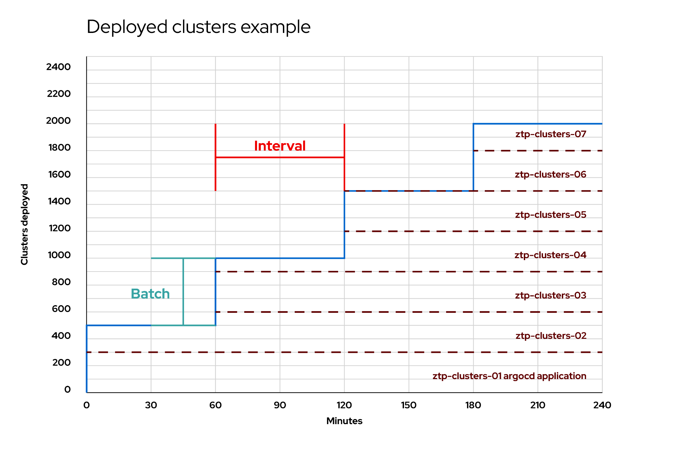
Enhanced scalability
Edge management at scale
Ensure scalability in low-bandwidth, high-latency sites
The number of single-node OpenShift clusters managed by a single Red Hat Advanced Cluster Management hub is 3,500.
Additionally, the IPV6 dual stack support simplifies the management of a scaled out edge architecture.
These features ensure scalability in low-bandwidth, high-latency connections and disconnected sites.

Slide 57
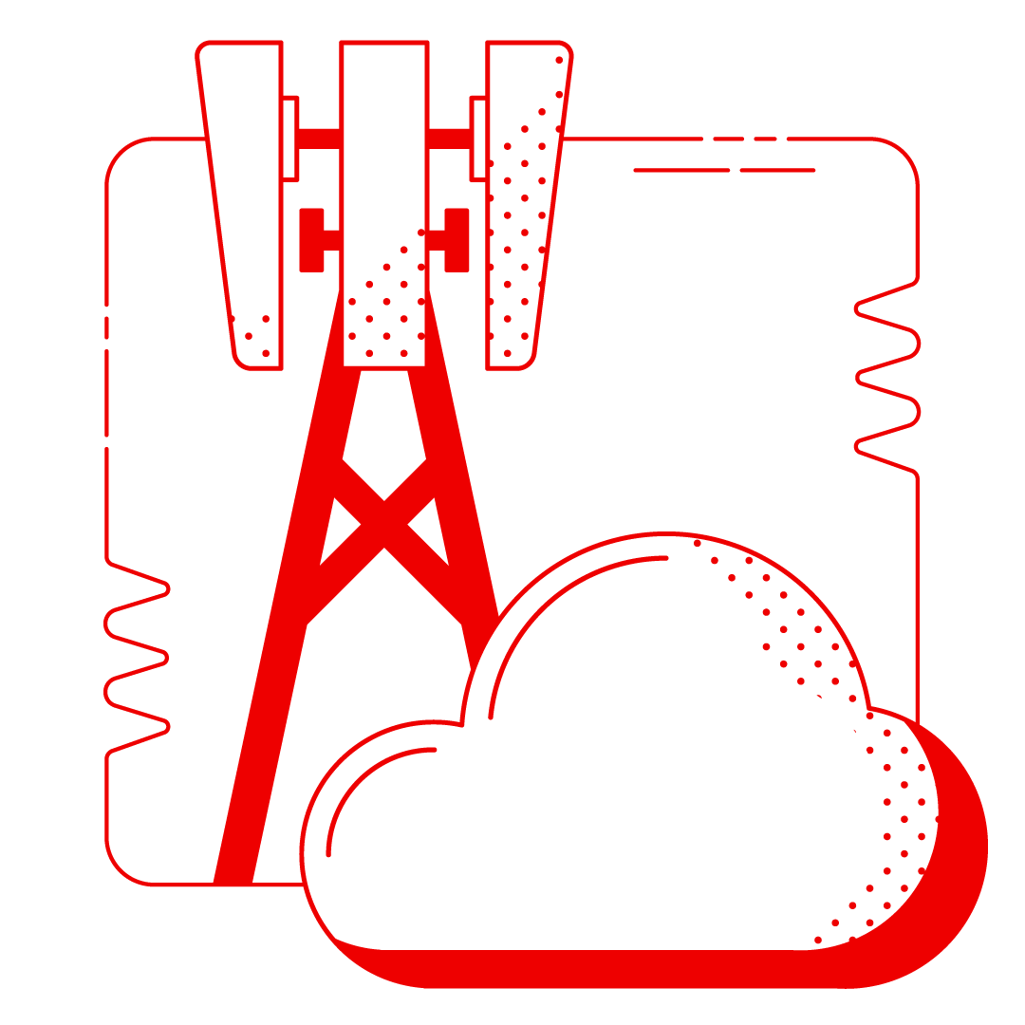
Zero touch provisioning and Red Hat Device Edge
Edge management at scale
High-scale cluster deployment, serving telco and edge scenarios
Use Red Hat Advanced Cluster Management with assisted installer on-premise and Topology Aware Lifecycle Manager (TALM) for high-scale cluster deployment, serving telecommunications and edge scenarios.
Zero touch provisioning combines ACM, GitOps, and policies to give service providers streamlined and automated cluster and network infrastructure lifecycle management at scale.
Streamlined deployment and management processes
Efficient MicroShift registration to Advanced Cluster Management, simplifying onboarding
Notes:
MicroShift Lifecycle Management with Advanced Cluster Management using FIDO Device Onboard

Slide 58
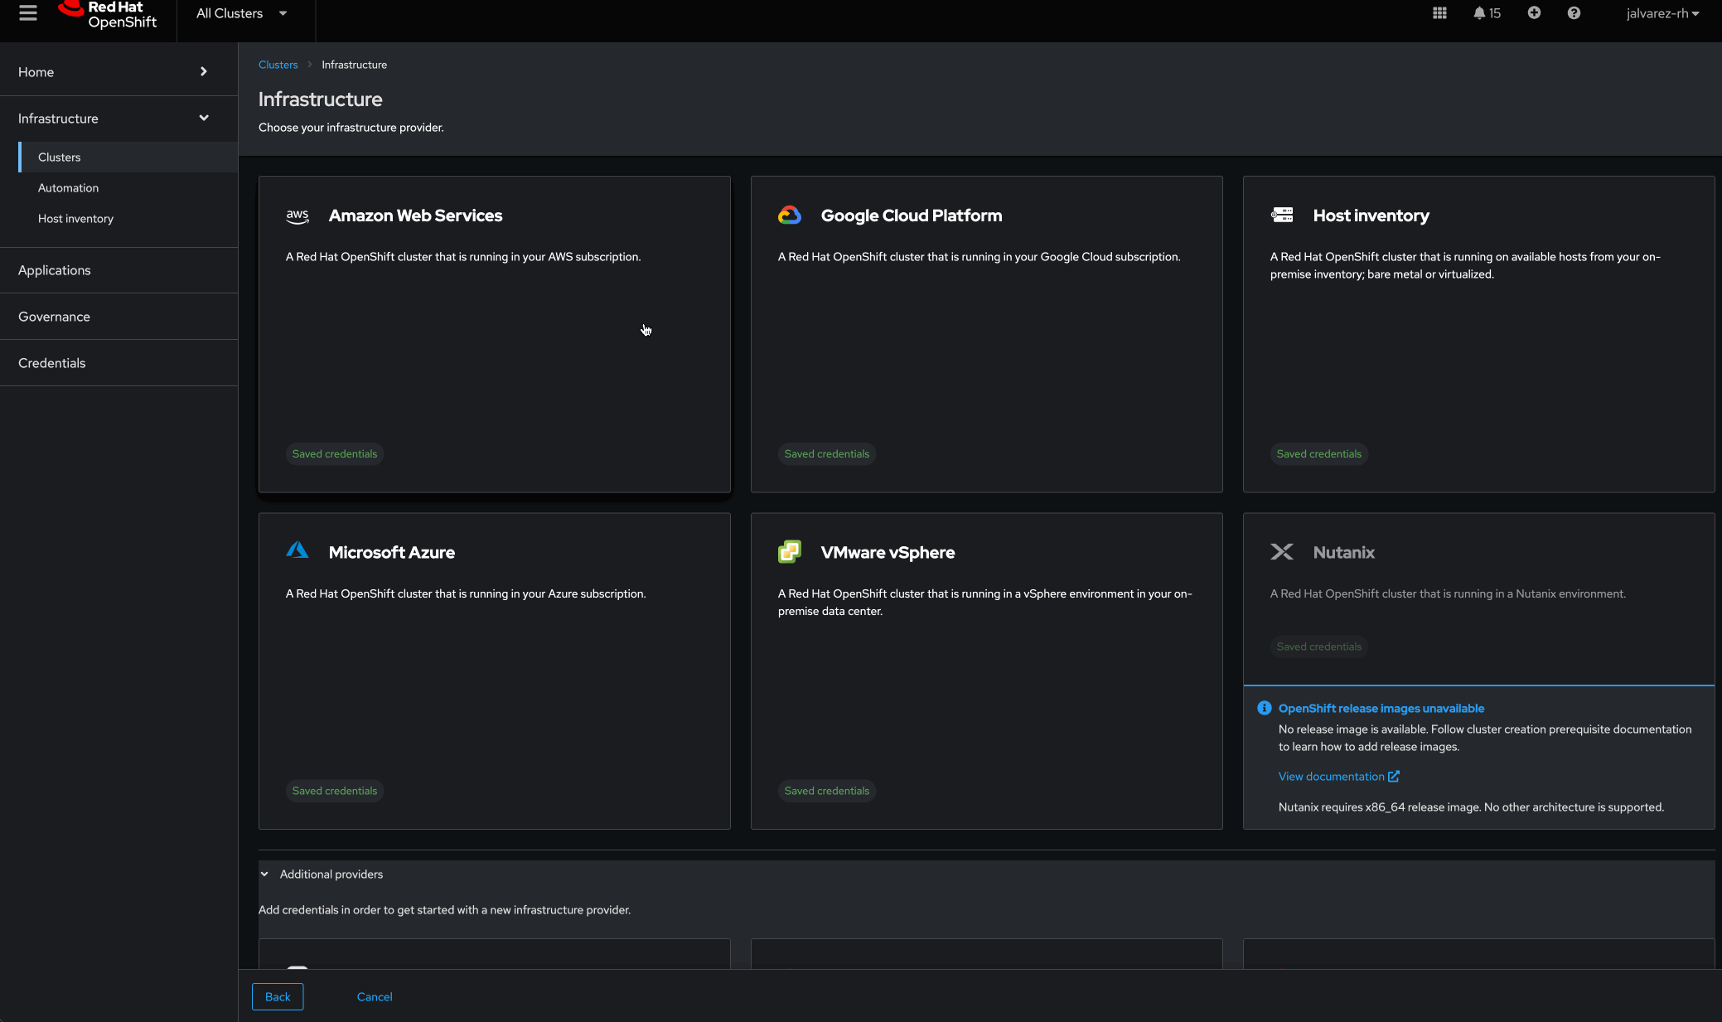
Single-node OpenShift management
Edge management at scale
Get full management capabilities for your single-node clusters
Get full management capabilities for your single-node OpenShift clusters (SNOs)—an essential feature for your edge use cases.
Provision SNOs on bare metal and in the cloud and add worker nodes on demand
Red Hat successfully tested the creation and management of 3,500 single-node OpenShift clusters

Slide 59
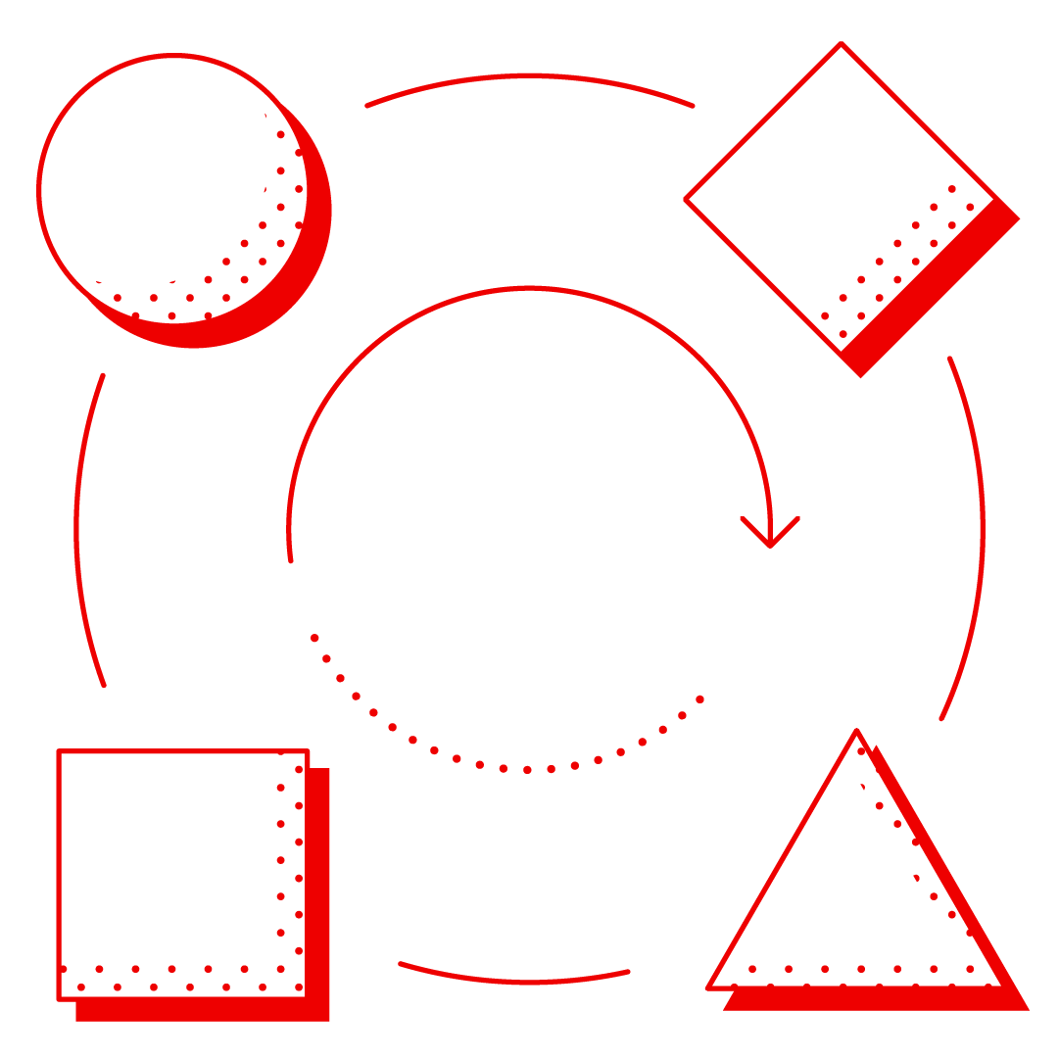
Topology Aware Lifecycle Manager
Edge management at scale
Manage the life cycle of your fleet in an orderly and predictable way
Group and sequence fleet-wide cluster upgrades
Uses Advanced Cluster Management’s Policy Engine and is driven by Red Hat GitOps
Schedule and trigger upgrades by supplying Topology Aware Lifecycle Manager (TALM) with parameters for the upgrade which conform to your operational requirements.
TALM manages a progressive rollout of the upgrade across the fleet, based on the set parameters
Image-based upgrades (IBU) provides you with a faster way to upgrade the platform version of a single-node OpenShift cluster.

Slide 60
Business continuity
Use case
Red Hat Advanced Cluster Management for Kubernetes

Slide 61


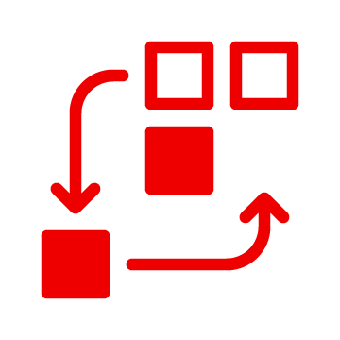
Business continuity
Business continuity
Ensure the applications your business relies on are always up and running
Red Hat Advanced Cluster Management Hub backup and restore Ensure the management configuration is not lost
Red Hat OpenShift Data Foundation for disaster recovery (DR) MetroDR, RegionalDR Provide a robust multisite, multicluster DR strategy for your stateful applications
PV replication using VolSync Provide a planned application migration strategy across your clusters

Slide 62
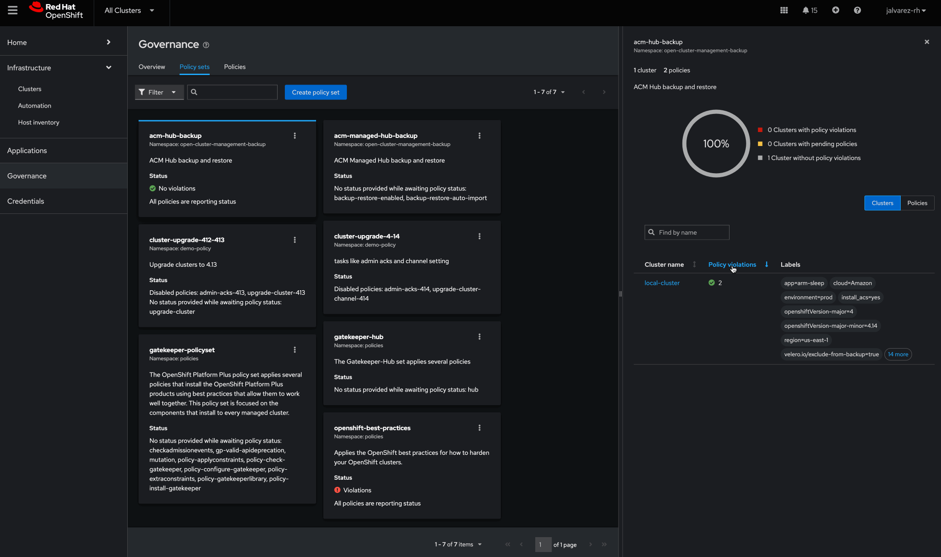
Red Hat Advanced Cluster Management Hub backup and restore
Business continuity
Ensure the management configuration is not lost
Back up your hub configuration and restore it in a different hub cluster, using a backup solution based on OpenShift API for Data Protection (OADP).
This ensures the management configuration is not lost and the continuity of business is maintained while applications continue to operate across the fleet.
OADP and ACM policies are behind the backup and restoration—with ACM policies helping inform the health of the backup flow.

Slide 63
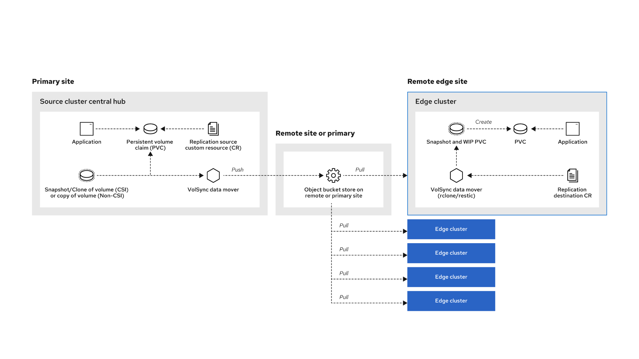
PV replication using VolSync
Business continuity
Ensure scalability in low-bandwidth, high-latency sites
Ensure resilience for the stateful applications your business relies on by providing a planned application migration strategy across your clusters.
You can use VolSync to create your own DR solution when working with alternative vendors’ storage or heterogeneous storage products.

Slide 64

Red Hat OpenShift Data Foundation for disaster recovery
Business continuity
Provide a robust multisite, multicluster DR strategy for your stateful applications
Provide a robust multisite, multicluster DR strategy for your stateful applications, using OpenShift Data Foundation and Red Hat Advanced Cluster Management.
OpenShift Data Foundation ensures your application data volumes and persistent volumes (PVs) are consistently and frequently replicated.
DR operators that are set up with Red Hat Advanced Cluster Management can automate the DR failover and failback processes asynchronously with Regional-DR for minimal recovery point objective (RPO) or synchronously with Metro-DR to achieve zero RPO.

Slide 65




Business continuity
Advanced Cluster Management asynchronous disaster recovery solution
Red Hat OpenShift Platform Plus
Business market
Advanced Cluster Management
Regional-DR plan
Region 1
Active
Region 2
Passive
Red Hat OpenShift Data Foundation enables cross cluster replication of data volumes
Storage operators synchronize both volume persistent data and kubernetes metadata
Enables failover and failback automation at application granularity, orchestrated by Red Hat Advanced Cluster Management
Data volume
Asynchronous replication
Data volume
OpenShift Data Foundation
OpenShift Data Foundation

Slide 66


Business continuity
Advanced Cluster Management synchronous disaster recovery solution
Red Hat OpenShift Platform Plus
Business market
Datacenter 1
Active
Advanced Cluster Management
Datacenter 2
Active
Metro-DR plan
Red Hat OpenShift cluster 1
Red Hat OpenShift cluster 2
OpenShift Data Foundation
Red Hat OpenShift Data Foundation makes it easier to deploy clusters in different datacenters to provide a fault isolated configuration
External mode cluster provides synchronous replicated volumes across the datacenters
Enables failover and failback automation at application granularity, orchestrated by Red Hat Advanced Cluster Management
External mode stretch cluster
Data volume
Synchronous replication
Data volume
Neutral zone
Arbiter node

Slide 67
Red Hat Advanced
Cluster Management
with OpenShift Platform Plus
Red Hat Advanced Cluster Management for Kubernetes

Slide 68

Red Hat OpenShift Platform Plus
OpenShift Platform Plus
A unified platform to build, modernize, and deploy applications at scale
Red Hat OpenShift and Red Hat Advanced Cluster Management provide the management platform and capabilities to work smarter and faster with a complete set of services for bringing apps to market on your hybrid cloud.

Slide 69





OpenShift Platform Plus
Red Hat OpenShift Platform Plus
Centralized application life cycle management and governance across multiple Kubernetes clusters
A consistent hybrid cloud foundation for building and scaling containerized applications
Built-in Kubernetes-native security for multicluster governance through the application life cycle
+
+
Persistent software-defined storage and essential data services integrated with Red Hat OpenShift
A scalable, central registry to provide a single source of truth and distribute it to multiple clusters
+

Slide 70













OpenShift Platform Plus
Red Hat delivers a complete open, hybrid cloud solution
Multicluster management
Cluster security
Global registry
Cluster data management
Manage workloads
Build cloud-native apps
Data-driven insights
Developer productivity
Platform services
Application services*
Data services*
Developer services
Kubernetes cluster services Install | Over-the-air updates | Networking | Ingress | Storage | Monitoring | Log forwarding | Registry | Authorization | Containers | VMs | Operators | Helm
Kubernetes (orchestration)
Linux (container host operating system)
Physical
Virtual
Private cloud
Public cloud
Edge
*Red Hat OpenShift® includes supported runtimes for popular languages/frameworks/databases. Additional capabilities listed are from the Red Hat Application Services and Red Hat Data Services portfolios.
**Disaster recovery, volume and multicloud encryption, key management service, and support for multiple clusters and off-cluster workloads requires OpenShift Data Foundation Advanced

Slide 71





Scale your operations with Red Hat OpenShift Platform Plus
OpenShift Platform Plus
Built-in security capabilities
Cluster-wide data management
Monitor running workloads for security issues with system-level data collection and security policies that can be applied and enforced throughout the application life cycle.
Performance at scale for data-intensive workloads, with support for all data protocols, data efficiency, resiliency, security, governance, and discovery.
Consistent operations
Developer tools
Apply consistent operational policies for security, configuration, compliance, and governance to Red Hat OpenShift clusters across on-premise and cloud infrastructures.
A library of supported tools, languages, databases, and frameworks to help you build, deploy, and run your applications and integrations for the latest developer tools verified to run with OpenShift.
End-to-end management
Support for DevSecOps
A uniform interface for administrators and developers provides consistent management whether the platform is installed on-premise, in the cloud, or at the edge.
Apply a DevSecOps approach and use Kubernetes-native controls to mitigate threats and enforce security policies that minimize operational risk to your applications.

Slide 72

Red Hat OpenShift Platform Plus delivers measurable results
OpenShift Platform Plus
US $1.5M
3-year benefit from DevOps hiring reductions
US $2.3M
203%
3-year return on investment
3-year benefit from reduced application downtime
US $3.1M
3-year benefit from improved developer productivity
*The Total Economic Impact™ Of Red Hat OpenShift Platform Plus, Forrester, January 2023

Slide 73

Red Hat Ansible Automation Platform integration
OpenShift Platform Plus
Automating life cycle management
Create Ansible-native access across your Kubernetes fleet:
Ansible integration allows for the delivery of straightforward and security-focused playbooks across your Kubernetes fleet.
Uses the multicluster engine for Kubernetes operator, Red Hat Advanced Cluster Management, and the stolostron.core Ansible Collection.

Slide 74




OpenShift Platform Plus
Ansible Automation Platform integration
Automating life cycle management
Cluster purpose A
IT ecosystem
Network
Security
Network
Security
IT service management
Red Hat OpenShift
Management Hub Cluster
Cluster purpose B
Red Hat Ansible Automation Platform
Network
Security
Red Hat Advanced Cluster Management for Kubernetes
Red Hat OpenShift
Cluster purpose …
Red Hat OpenShift
Cluster purpose …
Cluster purpose …
Management and application deployment
End-to-end automation
Notes:
Step 1: Managed clusters provisioned or imported
Step 2: RHACM hub calls Ansible Automation with template job ID defined in provisioning pre- and post-action
Step 3: Ansible Automation executes job to update security, storage and more
Step 4: Provisioning status and Ansible job execution represented in RHACM

Slide 75

Red Hat OpenShift Cloud Services
OpenShift Platform Plus
Build, modernize, and deploy applications at scale on the cloud provider of your choice
Cloud native solutions with the leading cloud providers:
Joint, cloud-native offerings on AWS, Microsoft Azure, and IBM Cloud
Full integration and access to native cloud tools and programs, streamlined billing, and integrated support
Seamless integration with Red Hat OpenShift Service on AWS to further accelerate the building and delivering of differentiating applications
Increase operational efficiency, refocus on innovation, and quickly build, deploy, and scale applications

Slide 76
Architecture and installation
Red Hat Advanced Cluster Management for Kubernetes

Slide 77










Architecture and installation
Architecture overview
Components
Hub architecture and components
Red Hat Advanced Cluster Management uses the multiclusterhub-operator and other operators and runs in the open-cluster-management namespace
Managed cluster architecture and components
Red Hat Advanced Cluster Management managed clusters use the klusterlet operator which runs in the open-cluster- management-agent namespace
Hub cluster
Managed cluster
Application programming interface
Console
Command line interface
Klusterlet
Search
Cluster life cycle
backed by MCE
Application
life cycle
Policy-based governance
Applications
Business continuity
Multi cluster observability
Multi cluster networking
Policy
Observability
Red Hat OpenShift Container Platform
+ other add-ons
* Multicluster Engine is the cluster life cycle operator that provides cluster management capabilities for OpenShift Container Platform and Red Hat Advanced Cluster Management hub clusters. MCE, for short, is entitled within OCP subscriptions and is installed automatically along with an ACM operator deployment.

Slide 78
Architecture overview
Architecture and installation
Components
Managed cluster
List of included components:
The klusterlet operator controls the deployment of components on the managed cluster.
Application manager
Certificate controller
Policy controller
Registration agent
Observability controller
Search collector
Cluster proxy
Identity and Access Management (IAM) policy controller
Work manager

Slide 79
Architecture and installation
Multicluster engine for Kubernetes operator
Advanced Cluster Management has repackaged core multicluster functionality into a new operator
Red Hat Advanced Cluster Management 2.4 and earlier
Multicluster engine for Kubernetes (MCE)
1.0 and later
Application life cycle
Multicluster networking
Cluster life cycle and foundation
Policy-based governance
Observability and search
The multicluster engine for Kubernetes operator is entitled with OpenShift and it’s installed automatically during a Red Hat Advanced Cluster Management install.
Cluster life cycle and foundation
Notes:
f

Slide 80


Architecture and installation
Advanced Cluster Management is the consumer of MCE
Red Hat Advanced Cluster Management is built on top of the multicluster engine operator
Red Hat Advanced Cluster Management
2.5, 2.6, 2.7, 2.8, 2.9, 2.10
Application lifecycle
Policy-based governance
Observability and search
Multicluster networking
+
Multicluster engine
2.0, 2.1, 2.2, 2.3, 2.4, 2.5
Cluster manager
Klusterlet
Discovery
Hive
Kubernetes Cluster API
Central infrastructure management and infrastructure operator
Hosted control planes

Slide 81
Architecture and installation
Red Hat Advanced Cluster Management
Managed clusters
Full life cycle management:
Any version of Red Hat OpenShift Container Platform 4.13 and above
Import and manage:
Red Hat OpenShift Container Platform 3.11
Red Hat OpenShift on IBM Power
Red Hat OpenShift on IBM Z
Red Hat OpenShift on IBM Cloud
Red Hat OpenShift Service on AWS
Microsoft Azure Red Hat OpenShift
Red Hat OpenShift Dedicated
OpenShift on ARM Developer
Limited life cycle support for managed Kubernetes clusters:
Amazon Elastic Kubernetes Service (Amazon EKS)
Azure Kubernetes Service (AKS)
IBM Cloud Kubernetes Service (IKS)
Google Kubernetes Engine (GKE)
Technical specifications
Hub cluster
Operator-based installation
Available on OperatorHub
Requires Red Hat OpenShift Container Platform, 4.13 and above
High availability
Red Hat OpenShift Container Platform availability zone supported
Minimum supported requirements:
Single-node OpenShift, 8 CPU cores, 16 GB of RAM, 120 GB
Recommended requirements:
Standard 3 control plane, 3 infrastructure nodes in different availability zones, 8 CPU cores, 16 GB of RAM, 120 GB*
*Resource consumption may vary depending on multiple factors. For more information on scale testing, visit this page
View the official support matrix

Slide 82
Customer success
Red Hat Advanced Cluster Management for Kubernetes

Slide 83






Business value delivered to Advanced Cluster Management customers
Customer success
Key performance indicator | Red Hat customer experience
Cost efficiency
Reduce effort spent on cluster management/compliance management
Revenue growth
Increase development velocity/ application development productivity
Risk mitigation
Reduce risk of compliance policy violation
Improved consistency across development and operations team
Used assisted installer to deploy hybrid instance quickly
Reduced application deployment from weeks to hours
Quickly innovated 5G and edge computing capabilities
Simplified management and compliances
Applied organizational policies to ensure security

Slide 84

Financial services: North America
Challenge
Discover needed a way to improve cluster management in their Red Hat® OpenShift environments. Discover was facing cluster sprawl across different countries. Managing these cluster versions, keeping them in sync, and operationalizing them using a single pane was challenging.
Solution
Discover used Red Hat Advanced Cluster Management to manage multiple clusters and enforce policies across different clouds, and manage applications in a GitOps methodology. Red Hat Advanced Cluster Management provides end-to-end visibility and control of the Kubernetes clusters from a central console.
Why Red Hat
Red Hat Advanced Cluster Management provides cluster lifecycle management and policy-based governance which help ensure consistent, reliable and secure Red Hat OpenShift environments for Discover’s high demand workloads.
Results
Sped up application development
Increased application availability
Simplified management and compliance
Products and services
Red Hat OpenShift
Red Hat Advanced Cluster Management
“We wanted to have an active inventory of clusters, manage the state of the clusters from a centralised point, and execute the workflows multiple times to reach that stage. We have really a huge number of clusters, and it's actually growing again. We needed to establish GitOps for OpenShift Cluster Management, and Red Hat helped us do that.“
Sriram Mageswaran
Principal Systems Architect,
Discover
84
Source: Red Hat Summit presentation. "The power of advanced cluster management for Kubernetes: Working with Discover to normalize their Kubernetes deployments," June 2021

Slide 85


Telecommunications: EMEA
Opportunity
As communication service providers prepare for the benefits 5G and edge will bring to core network functions, Telefónica plans to have an open, secured, intelligent, and highly automated network that can power transformation for consumer and enterprise customers across all industries.
Solution
Telefónica is implementing UNICA Next, the company’s first cloud-native, 5G core network platform. The platform is planned to be a new open-standard, open-networking technology compliant platform that will be deployed across multiple central, regional, and distributed datacenters offering low latency and high bandwidth, while able to deliver services in a fully automated fashion.
Why Red Hat, IBM and Juniper
Pairing the IBM network automation and Red Hat® container platform and management solutions presents Telefónica with an environment designed for increased observability and control for managing the UNICA Next environment while driving 5G and edge innovation more quickly and with less complexity.
Products and services Partners
Red Hat OpenShift® IBM, Red Hat, Juniper
Red Hat Advanced Cluster Management
IBM Cloud Pak for Network Automation
Juniper SDN and Fabric
“5G has the potential to support thousands of use cases and applications for consumers and enterprises in all industries. Our collaboration will not only help us to harness the potential of 5G, but also prepare for the future through a hybrid-cloud led technology and business transformation.”
Javier Gutierrez, Director of Strategy, Network, and IT Development, Telefónica
85
Source: Press release. “Telefónica Chooses IBM To Implement Its First-Ever Cloud-Native 5G Core Network Platform,” Sept. 2021.
Notes:
IBM announced a strategic multi-year agreement with Telefónica to use IBM intelligent automation software and services to implement UNICA Next – Telefónica's first-ever, cloud-native, 5G core network platform.Telefónica has engaged IBM Global Business Services, Red Hat and Juniper networking to deploy the cloud-native platform. The platform is planned to be a new open-standard open-networking technology compliant platform that will be deployed across multiple central, regional, and distributed data centers offering low latency and high bandwidth, while able to deliver services in an agile manner. UNICA Next data centers are planned to be deployed starting in October 2021.

Slide 86

Telecommunications: EMEA
Challenge
With ongoing growth in demand for data-intensive services and new digital experiences, VodafoneZiggo needed to modernize its network and IT systems to increase agility, manage complexities, and encourage efficiencies. The provider was looking for supplier-agnostic technology to enable its multivendor infrastructure.
Solution
VodafoneZiggo selected Red Hat® OpenShift® as its foundation for cloud-native applications across both the network and the business, with its new 5G Core network as its first deployment. Red Hat Advanced Cluster Management provides cloud management and compliance enforcement for the OpenShift clusters at scale.
Why Red Hat
VodafoneZiggo ran a successful proof of concept with OpenShift. Also, the provider had already been using Red Hat OpenStack® Platform for its 4G mobile core and several business applications.
Results
Better consistency across development and operations teams, such as moving ideas more quickly from development to production
Increased security features, such as implementing a continuous systems security approach for network and container isolation and data access control
Increased scalability across multiple clouds and to the edge
“We trusted in Red Hat’s well established set of partnerships to provide supplier independence.”
André Beijen
Director, Mobile Network, VodafoneZiggo
86
Source: Red Hat VodafoneZiggo press release. Oct. 2021.
Notes:
Products and services
Red Hat OpenShift
Red Hat Advanced Cluster Management
Red Hat Consulting
VodafoneZiggo is one of the leading communication and entertainment service providers for consumers and businesses in the Netherlands. With the ongoing growth in demand for data-intensive services and new digital experiences, VodafoneZiggo is continuously modernizing its network and IT systems to increase its agility, manage complexities and drive efficiencies. The company selected Red Hat OpenShift as its foundation for cloud-native applications across both the network and the business, with 5G Core as its first deployment. After a successful proof of concept, VodafoneZiggo enlisted Red Hat Consulting to support the production roll out of Red Hat OpenShift and to provide guidance for embracing agile development models like DevSecOps as well as moving to a more open, collaborative culture. With Red Hat OpenShift as its container platform, VodafoneZiggo will be able to scale out more rapidly and efficiently across multiple clouds and to the edge as business needs and market demands evolve.

Slide 87

Manufacturing: EMEA
Airbus Helicopters meets data science
analysis needs to support new
business opportunities
“Red Hat OpenShift Platform Plus provides a complete set of tools that are fully integrated, fully deployed, and easy to use, as well as more OpenShift operators to meet new business requirements. This all-in-one approach is an added value for us.”
Alexandre Barbier
Product Owner,
Containers and End-to-End Monitoring,
Airbus Helicopters
Challenge
Sought to expand the capabilities of its container platform to support new development features and data science needs.
Solution
Worked closely with technology partner Capgemini, the company upgraded from a virtualized Red Hat OpenShift® Container Platform 3 environment to Red Hat OpenShift Platform Plus running on bare metal.
Results
Established scalable data science foundation
Reduced application deployment times from days to hours
Shortened cluster upgrades from days to hours
87
Source: Red Hat case study.“Airbus Helicopters meets data science analysis needs to support new business opportunities,” June 2023.
Notes:
Software
Red Hat® OpenShift® Platform Plus
Partner
Capgemini
Airbus Helicopters, a division of Airbus and a leader in designing, manufacturing, and delivering helicopters, sought to expand the capabilities of its container platform to support new development features and data science needs. With help from technology partner Capgemini, the company upgraded from a virtualized Red Hat OpenShift Container Platform 3 environment to Red Hat OpenShift Platform Plus running on bare metal. The new security, compliance, application, and data management capabilities have helped Airbus Helicopters support processing of massive volumes of data, deploy applications faster, and complete cluster maintenance more efficiently.

Slide 88

“Red Hat OpenShift Platform Plus provides a one-step update for platform services and applications. We can
fully upgrade a cluster— including the operating system—in just a few hours, rather than three or four days.”
Philippe Raboutot
Red Hat OpenShift Expert,
Capgemini
88
Source: Red Hat case study.“Airbus Helicopters meets data science analysis needs to support new business opportunities,” Jun 2023.
Notes:
Software
Red Hat® OpenShift® Platform Plus
Partner
Capgemini
Airbus Helicopters, a division of Airbus and a leader in designing, manufacturing, and delivering helicopters, sought to expand the capabilities of its container platform to support new development features and data science needs. With help from technology partner Capgemini, the company upgraded from a virtualized Red Hat OpenShift Container Platform 3 environment to Red Hat OpenShift Platform Plus running on bare metal. The new security, compliance, application, and data management capabilities have helped Airbus Helicopters support processing of massive volumes of data, deploy applications faster, and complete cluster maintenance more efficiently.

Slide 89

Manufacturing: EMEA
Infineon Technology AG uses Red Hat OpenShift Platform Plus as Hybrid Cloud Platform
Challenge
Infineon wanted to establish a standardized hybrid cloud platform and a scalable cloud-native infrastructure for custom application development and custom off-the-shelf applications, while supporting its mission to make life easier, safer, and greener.
Solution
The evolution of Infineon’s Red Hat® OpenShift® environment encouraged Infineon to switch to Red Hat OpenShift Platform Plus for a unified set of services, principally its centralized advanced cluster security capabilities.
Results
Created state-of-the-art scalable infrastructure that can scale in minutes instead of hours, days, or even weeks
Accelerated processes resulting in faster time-to-market
Increased security of intellectual property
“Red Hat OpenShift Platform Plus simplifies a lot since you don’t have to interoperate with so many other systems from a traditional environment. An idea can be brought to market faster.”
Hansjörg Sonnleitner
Senior Vice President Operational Services,
Infineon Technology AG
89
Source: Red Hat case study. “Infineon Technology AG uses Red Hat OpenShift Platform Plus,” Apr 2023.
Notes:
Software and services
Red Hat® OpenShift® Platform Plus, including Advanced Cluster Security (ACS)
Red Hat Technical Account Management
Red Hat Training
Founded and headquartered in Germany, Infineon Technologies AG is a global semiconductor leader in power systems and IoT. Infineon drives decarbonization and digitalization with its products and solutions. The company has around 56,200 employees worldwide and generated revenue of about €14.2 billion in the 2022 fiscal year (ending 30 September). While further expanding the manufacturing capacities and continuing to grow in terms of revenue, it needed to ensure the performance and security of its processes. The company decided to switch to a container environment for the internal development of dedicated tools used in semiconductor development and production. Thanks to the enterprise-supported technologies and hands-on guidance from its Training and Technical Account Management programs, Red Hat proved to be a great partner to help Infineon speed up and simplify processes, while keeping proprietary information safe.

Slide 90

Customer perspective
Overview
Researchers and students rely on Georgia Tech’s IT team for guidance on the best modern technology approaches, specifically to replace costly, hardware-intensive traditional methods. We recently interviewed Mark Danielson, Systems Architect, IT Lead, College of Engineering, Georgia Institute of Technology, to get his view on the importance of open source:
Why open source
“Open source allows us to avoid being locked into one particular vendor. Moreover, if we need to integrate NetApp or F5 technology, for instance, with one of our open source solutions, chances are other people in the open source community have already done that. So taking advantage of Red Hat’s commitment to the open source community has made these types of challenges easier.”
Investment in Red Hat OpenShift Platform Plus
“We migrated all our OKD workloads to Red Hat® OpenShift® Platform Plus, running on premise, early last year when the legacy infrastructure our OKD was running on was replaced. Today, different material science disciplines are using OpenShift Platform Plus for all sorts of workloads, including artificial intelligence (AI).”
Deployed package based on legacy script with API on Red Hat OpenShift within two months
Red Hat Advanced Cluster Management for Kubernetes assisted installer invaluable for hybrid installation
Implemented Red Hat Quay and GitHub runners to start CI/CD pipelines and infrastructure as code endeavors
90
Source: Red Hat Case Study: Georgia Institute of Technology advances innovation with open source flexibility. Interview with Mark Danielson, Systems Architect, IT Lead, College of Engineering, Georgia Institute of Technology, June 2023.

Slide 91
Success with the Red Hat partner ecosystem
Red Hat Advanced Cluster Management for Kubernetes

Slide 92

“We’re able to scale and secure telco-specific protocols not currently supported by Kubernetes by working closely with Red Hat and its OpenShift Platform to provide a cloud-like platform with high performance and low latency.”
Benito Lopez
Senior Manager of Business Development,
F5
92
Source: Kubecon + CloudNativeCon NA 2020, “Ken Holtz, Red Hat and Benito Lopez, F5 | Kubecon + CloudNativeCon NA 2020” Nov. 2020.

Slide 93
“Ecosystems partnerships are going to be critical to our success as a company. Red Hat is a leader in open source and open end containers for their OpenShift Platform and a vital partner in working with service providers to transform their networks.”
Benito Lopez
Senior Manager of Business Development,
F5
93
Source: Kubecon + CloudNativeCon NA 2020, “Ken Holtz, Red Hat and Benito Lopez, F5 | Kubecon + CloudNativeCon NA 2020” Nov. 2020.

Slide 94

Technology: NA
Challenge
Tap into the potential of 5G to support crucial uses that benefit from the few milliseconds of latency saved by not having to send workloads to a centralized cloud.
Solution
Provide new offerings running on Red Hat® OpenShift® to enable enterprises to overcome the complexity of managing workloads across a massive volume of devices from different vendors, and give telcos the agility to quickly deliver edge-enabled services.
Why Red Hat
IBM's new offerings run on Red Hat OpenShift, the leading enterprise Kubernetes platform that runs everywhere - from the data center to multiple public clouds to the edge – combining IBM’s expertise with Red Hat's industry-leading technology.
Results
Enabled clients across industries to fully realize the benefits of edge computing
Deployed Red Hat OpenShift to deliver intelligent automation capabilities to orchestrate virtual and container network functions in minutes
Used Red Hat OpenShift and Red Hat OpenStack® Platform to enable telcos to modernize networks for greater agility and efficiency
Products and services
Red Hat OpenShift Red Hat OpenStack Platform
“In today's uncertain environment, our clients are looking to differentiate themselves by creating more innovative, responsive user experiences that are adaptive and continuously available – from the data center all the way out to the edge.”
Denis Kennelly General Manager, IBM Hybrid Cloud
94
Source: Red Hat IBM press release, “IBM and Red Hat Launch New Edge Computing Solutions for the 5G Era,” May 2020.

Slide 95
“IBM is helping clients unlock the full potential of edge computing and 5G with hybrid multicloud offerings that bring together Red Hat OpenShift and our industry expertise to address enterprise needs in a way no other company can.“
Denis Kennelly General Manager, IBM Hybrid Cloud
95
Source: Red Hat IBM press release, “IBM and Red Hat Launch New Edge Computing Solutions for the 5G Era,” May 2020.

Slide 96

Telecommunications: North America
Challenge
Develop common solution blueprints for transformation to 5G for Mavenir’s 5G Core, vRAN, and IP Multimedia Subsystem (IMS) workloads.
Solution
Mavenir announced a strategic collaboration with Red Hat to certify Mavenir applications for mobile networks with Red Hat® OpenShift Container Platform®.
Why Red Hat
Mavenir believes that the future of mobile communication is built on open hybrid cloud, Linux containers, and cloud-native microservices, giving both communications service providers and enterprises, the ability to implement a variety of 5G services, like network slicing and edge computing, in an agile and automated way.
Results
Delivered solutions that ease deployment on mobile network
Helped deliver 5G services, such as massive machine-type communications (mMTC)
Provided ultra-reliable, low latency communications with greater agility and automation
Products and services
Red Hat OpenShift
“We are proud to work with a leading company like Red Hat to certify our workloads and to continue to demonstrate the capabilities of Mavenir cloud-native software.”
Pardeep Kohli
President and CEO,
Mavenir
96
Source: Red Hat Mavenir press release, “Mavenir and Red Hat Collaborate to Transform Mobile Network Infrastructures,” Feb. 2021.
Notes:
Additional news with Mavenir and Red Hat
Mavenir Introduces Open vRAN Containerized Solution for Hybrid and Multi-Cloud Deployment with Red Hat
Mavenir Introduces Converged Packet Core Solution for Hybrid and Multi-Cloud Deployment with Red Hat

Slide 97
“We are looking forward to collaborating and demonstrating our agility together to deliver high-quality software for our customers, boosting the 5G cloud-native ecosystem.”
Pardeep Kohli
President and CEO,
Mavenir
97
Source: Red Hat Mavenir press release, “Mavenir and Red Hat Collaborate to Transform Mobile Network Infrastructures,” Feb. 2021.

Slide 98
What's new in
Red Hat Advanced Cluster Management 2.11
Red Hat Advanced Cluster Management for Kubernetes

Slide 99

Red Hat Advanced Cluster Management
What’s new in 2.11 - Highlights
Expanded Kubernetes support matrix
Automated ROSA import - DP
Global Hub Search - TP
Enhanced OLM operator integration - GA
Policy violation debug (diff) in the UI
OpenShift Virtualization enhancements
Right-sizing - Enhanced DP
Fine-grained RBAC for RHACM Observability - TP

Slide 100




Red Hat Advanced Cluster Management for Kubernetes 2.11
Extended Support Matrix
RHACM is committed to embracing Kubernetes diversity
In addition to already supporting management across OpenShift and public cloud Kubernetes services, we now include an expanded support matrix, including support for all distributions in the Certified Kubernetes Conformance Program.

Slide 101

Red Hat Advanced Cluster Management for Kubernetes 2.11
Developer Preview (DP)
Automated ROSA import
Reduce time and manual errors in onboarding your existing ROSA clusters
The new automated discovery and import feature scans your AWS environment, identifies ROSA clusters, and imports them automatically into the management hub. ROSA import documentation

Slide 102

Red Hat Advanced Cluster Management for Kubernetes 2.11
Tech Preview (TP)
Global Hub - Global Search
Your Multicluster Command Center
Have a unified management view for all of your clusters across all hubs. Perform cross-hub searches to quickly find resources, regardless of location. Define and personalize saved searches that you regularly come back to and export results to a CSV report that can be used across adjacent teams. Global Search documentation
[1] Global Inventory Search View technical preview now - ACM 2.11 (OCP 4.16)
*

Slide 103

Red Hat Advanced Cluster Management for Kubernetes 2.11
Generally Available (GA)
Operator Lifecycle Manager integration
Get improved operator management with Operator Policies
Users and customers streamline installation and management of operators at scale with native integration, ensuring seamless operations across clusters. Operator Policy documentation

Slide 104

Red Hat Advanced Cluster Management for Kubernetes 2.11
Generally Available (GA)
Policy violation debug
Policy “diff” now generally available in the UI
Visualize the “diff”-erence between the current state of configured resources vs. the desired state of the Policy using either the UI or API. Policy Debug Log documentation

Slide 105



Red Hat Advanced Cluster Management for Kubernetes 2.11
Generally Available (GA)
OpenShift Virtualization enhancements
Observe containerized and virtualized workloads across the hybrid cloud
Use enhanced Search to quickly see all virtual machines on your fleet. Gain deeper insights and visibility into your OpenShift Virtualization inventory with a ready-to-use dashboard.

Slide 106


Red Hat Advanced Cluster Management for Kubernetes 2.11
Enhanced Developer Preview (DP)
Right-sizing
Optimize resource allocation in cluster namespaces
RHACM’s right-sizing analyzes cluster resource usage and provides recommendations for requests and limits, which can lead to significant cost savings.
Right-sizing explainer blog

Slide 107
Red Hat Advanced Cluster Management for Kubernetes 2.11
Tech Preview (TP)
Fine-grained RBAC for RHACM Observability
Enhance security and reduce cognitive load with granular control over observability access.
kind: ClusterRole
apiVersion: rbac.authorization.k8s.io/v1
metadata:
name: ocm-metrics-access
rules:
- verbs:
- metrics/open-cluster-management-agent
- metrics/open-cluster-management-agent-addon
apiGroups:
- cluster.open-cluster-management.io
resources:
- managedclusters
resourceNames:
- devcluster1
- devcluster2
kind: ClusterRoleBinding
apiVersion: rbac.authorization.k8s.io/v1
metadata:
name: ocm-metrics-access-binding
subjects:
- kind: User
apiGroup: rbac.authorization.k8s.io
name: user1
roleRef:
apiGroup: rbac.authorization.k8s.io
kind: ClusterRole
name: ocm-metrics-access
Fine-grain RBAC provides namespace-level granularity by limiting access to specific namespaces. Each team in the organization may now only see metrics restricted to their own teams.
RBAC documentation

Slide 108




Red Hat Advanced Cluster Management for Kubernetes 2.11
Other Enhancements
Enhanced control and insights features
4.14 EUS
4.16 EUS
T-shirt sizing RHACM Observability Stack
(DP)
Multi-cluster Observability for Red Hat Device Edge (DP)
Upgrade risks in the Fleet View Powered by Red Hat Insights
Gatekeeper operator uplift 3.15.1
EUS to EUS direct upgrades in RHACM documentation
These updates will help simplify operations across diverse Kubernetes environments, automate routine tasks, improve visibility into cluster health and performance and enhance their security posture.

Slide 109

RHACM 2.11 Changelog
Red Hat Advanced Cluster Management for Kubernetes 2.11
Summary of enhancements & features
Cluster Lifecycle
Observability
Governance
ROSA import DP
Device Edge DP
EUS to EUS upgrades
RHACM Hub node scaling
Fine grained RBAC for Observability TP
OpenShift Virtualization Observability
Upgrade Risks in RHACM Fleet view UI
T-Shirt-Sizing of Observability DP
Right Sizing DP
Global Search - including partial matches
Gatekeeper uplift 3.15.1
Enhanced OLM operator integration GA
Policy debug log “diff” GA

Slide 110
Resources
Red Hat Advanced Cluster Management for Kubernetes

Slide 111





Resources
View the webpage ▸
Get the datasheet ▸
Get product documentation ▸
View the YouTube playlist ▸
Infographics
The move to multicluster ▸
Bridging hybrid cloud environments ▸
E-book
Managing your Kubernetes clusters for dummies ▸
Checklists
5 considerations for managing your Kubernetes clusters ▸
5 considerations for upgrading to Red Hat OpenShift Platform Plus ▸
Start your trial

Slide 112
Thank you
Red Hat is the world’s leading provider of enterprise open source software solutions. Award-winning support, training, and consulting services make
Red Hat a trusted adviser to the Fortune 500.

